Slide 1
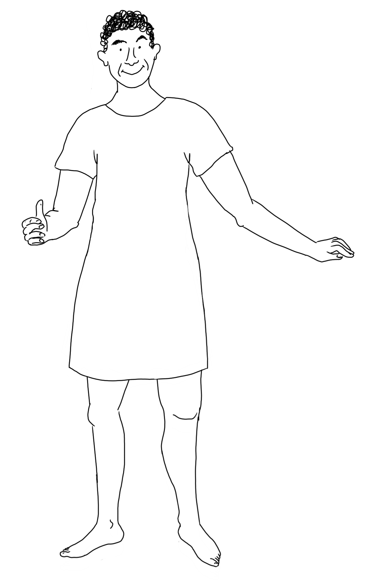
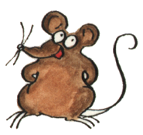
Dress & label the Roman soldier
galea
gladius
pilum
scutum
lorica
pugio
cingulum
fascia or focale
caligae
tunica

