Slide 1
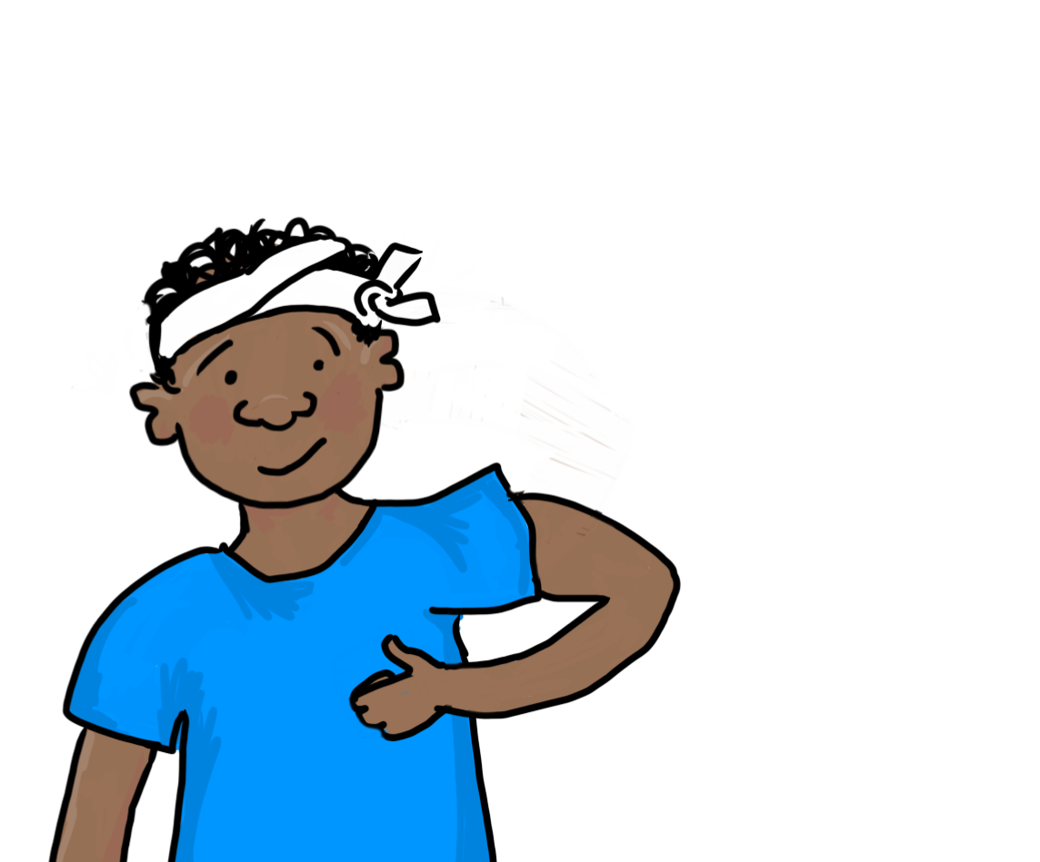
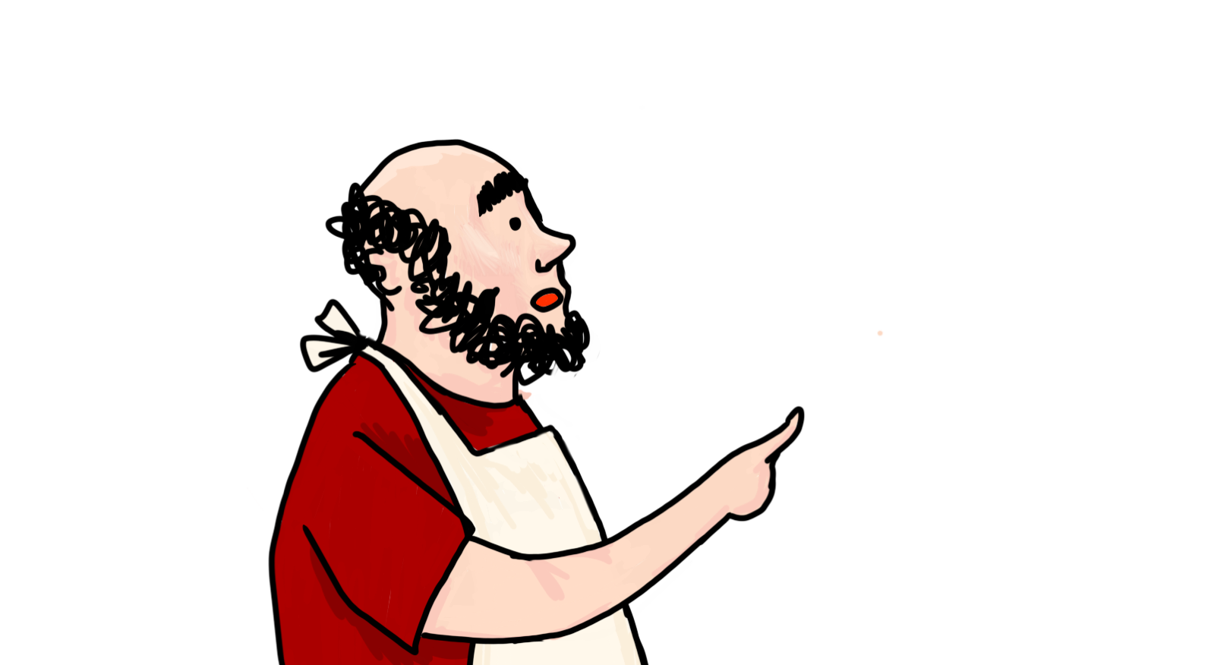
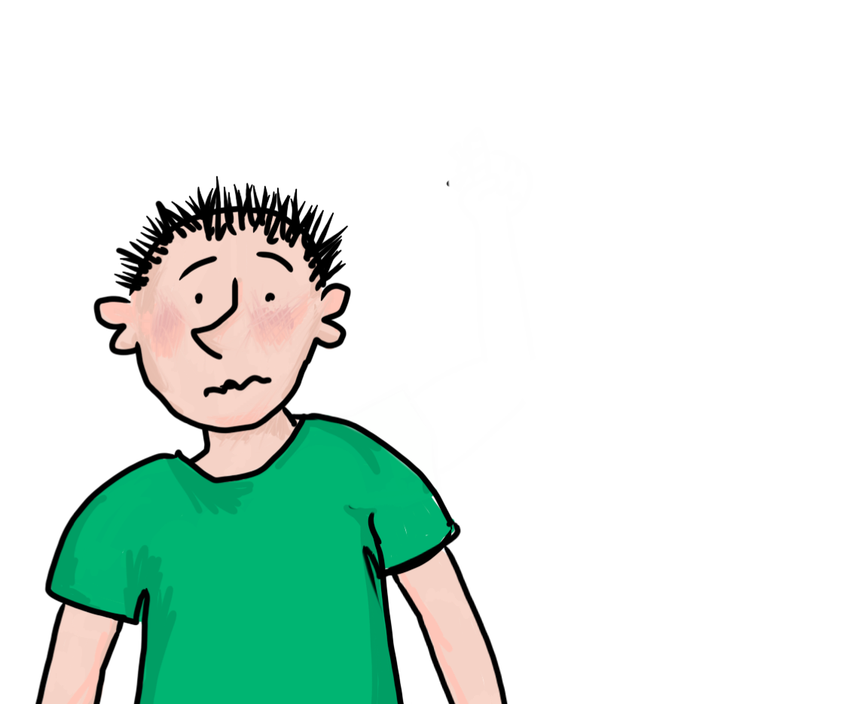
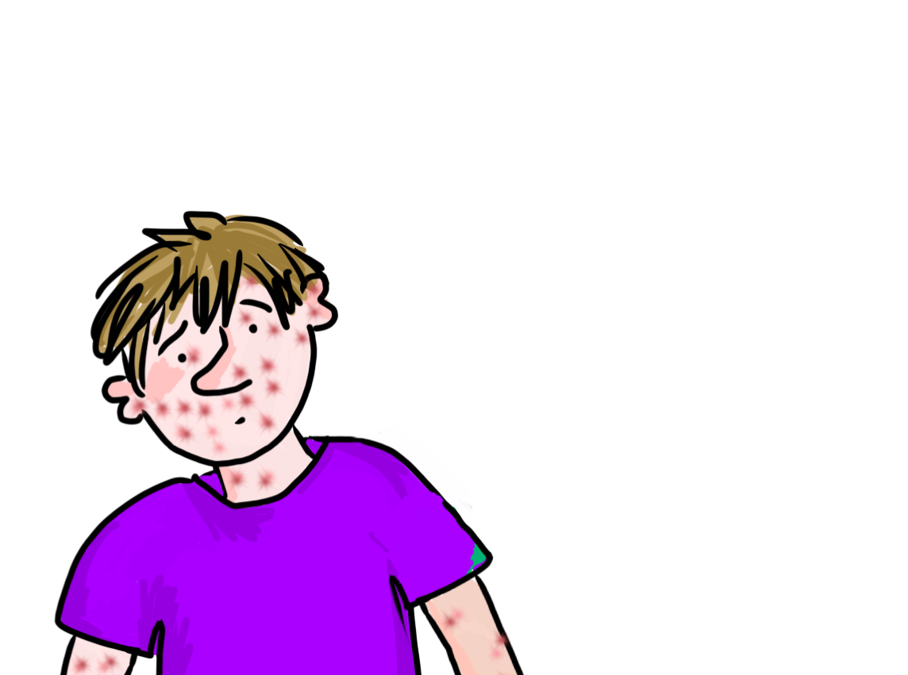
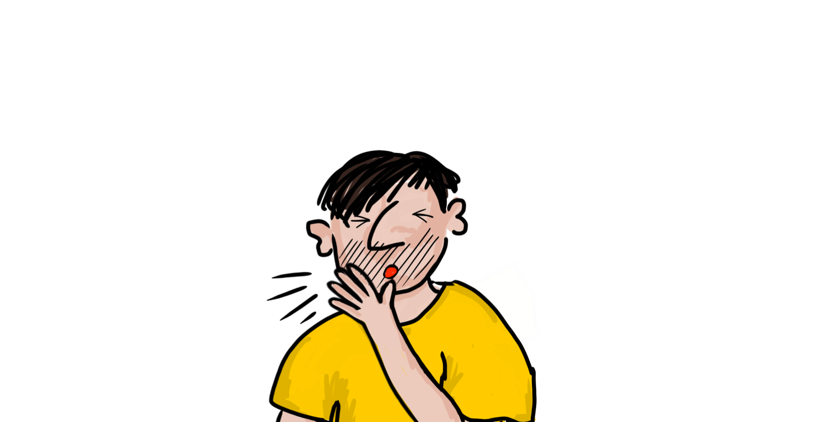
medice! medice!
Interactive Latin doctor’s surgery
Dr Helen Forte

Slide 2
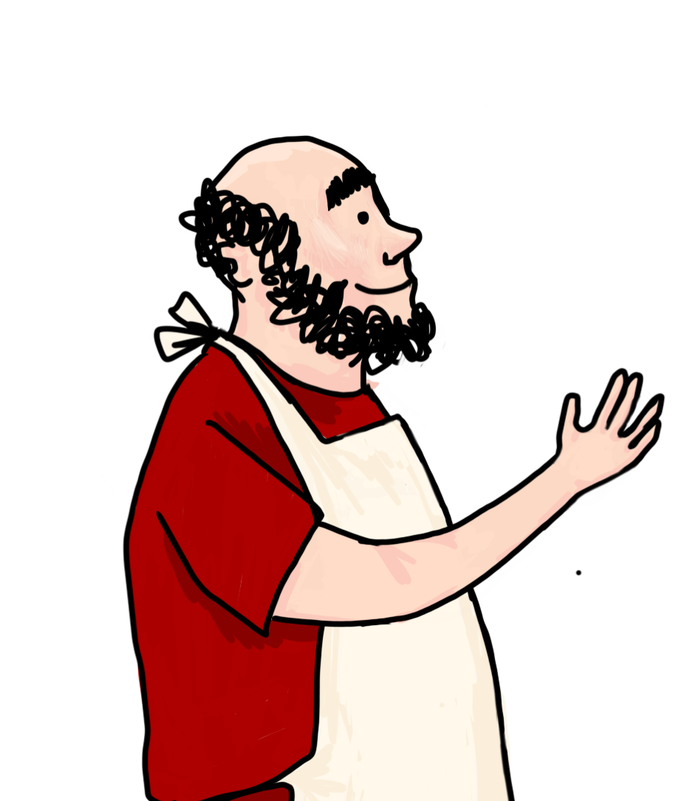
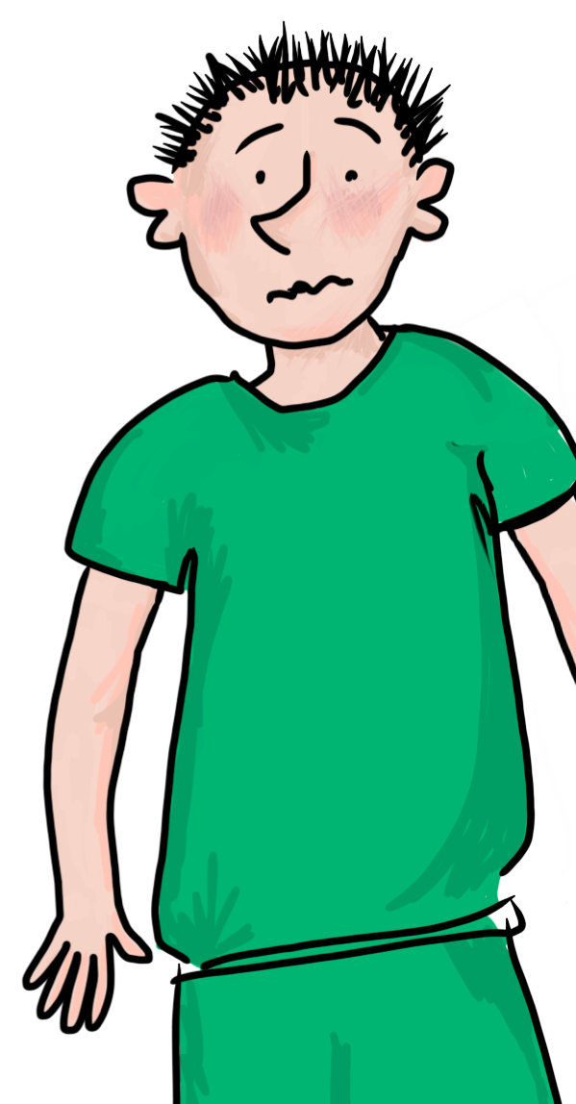
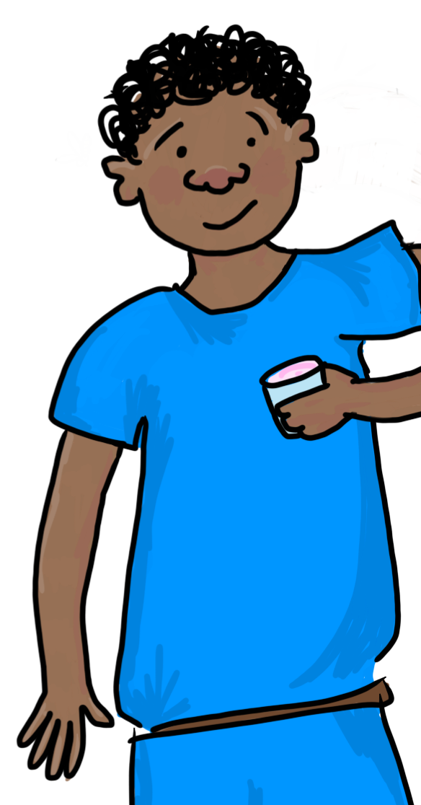
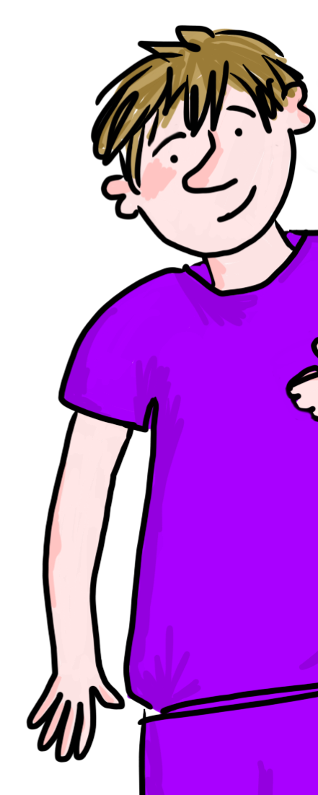
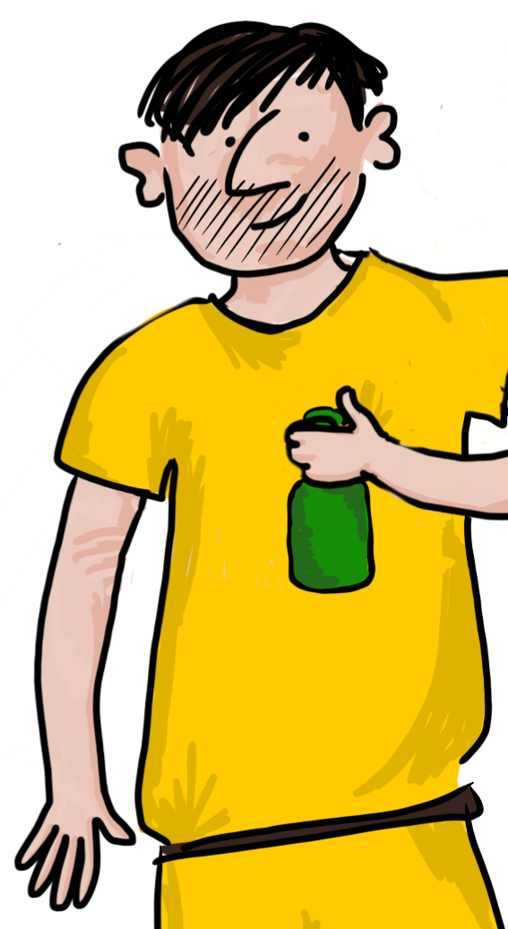
click a speech bubble to choose your patient
salvete!
salve!
salve!
salve!
salve!

Slide 3
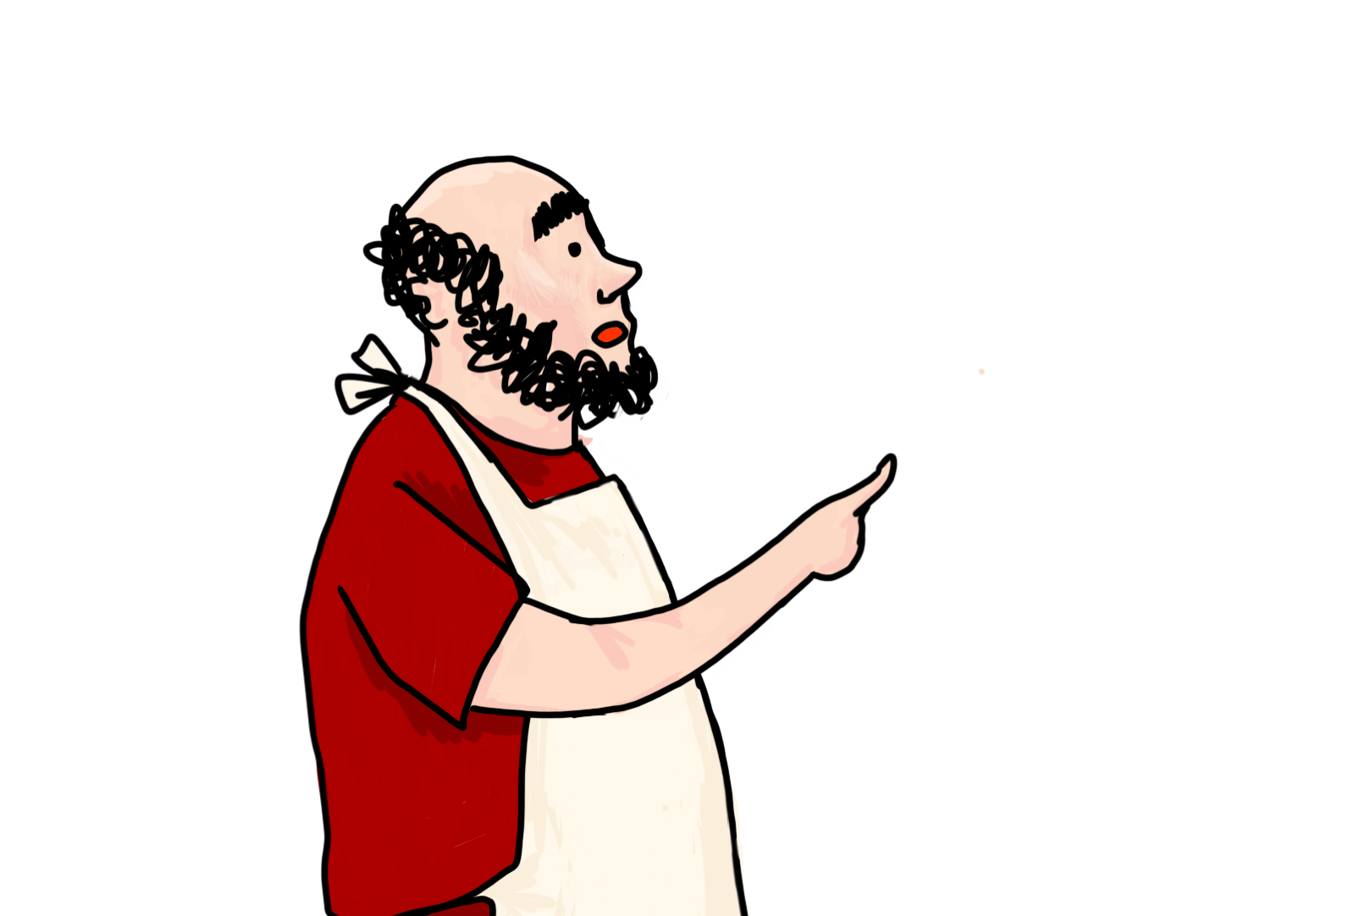
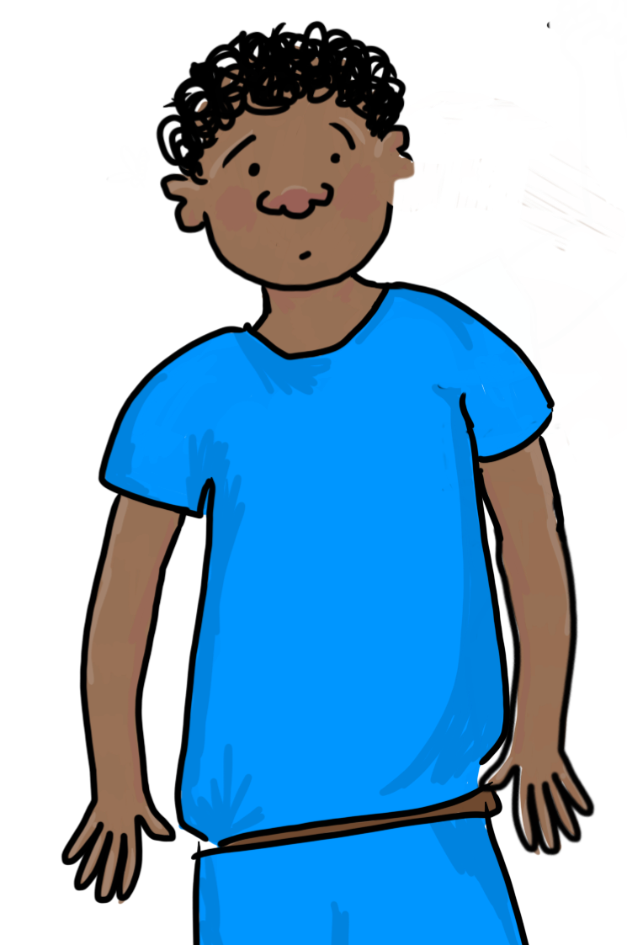
quid tibi dolet?
?
pick a problem
?

Slide 4
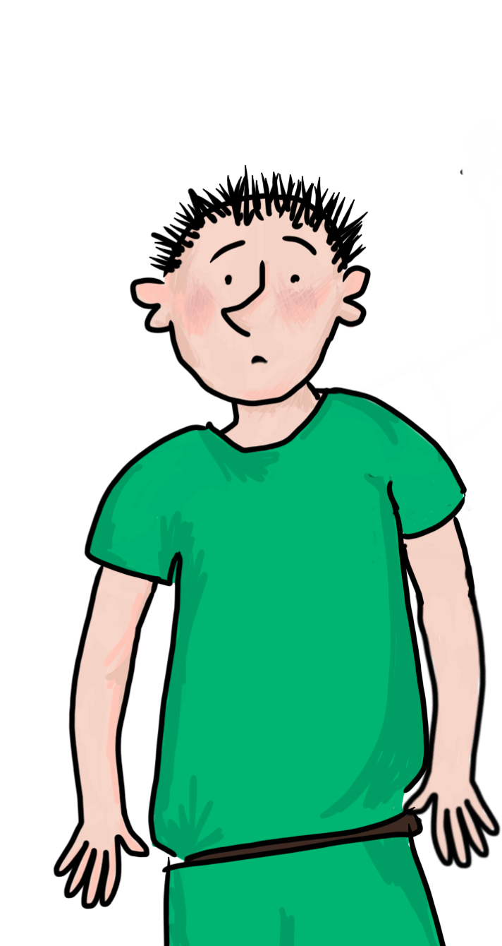
quid tibi dolet?
pick a problem
?
?

Slide 5
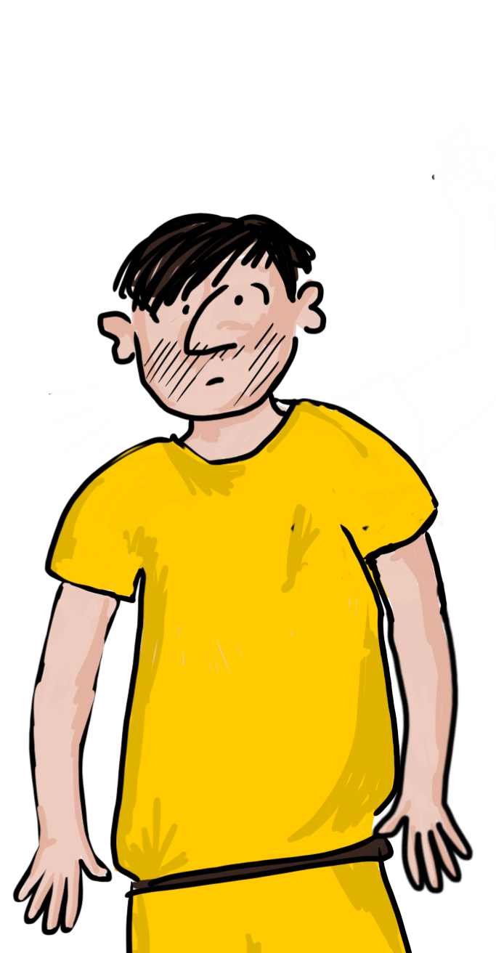
quid tibi dolet?
pick a problem
?
?

Slide 6
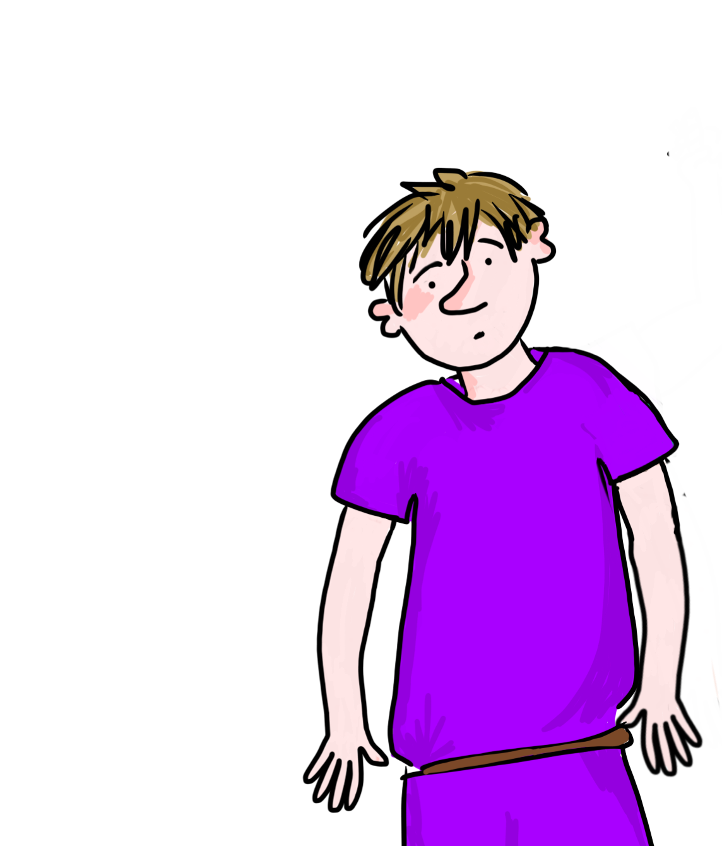
quid tibi dolet?
pick a problem
?
?

Slide 7
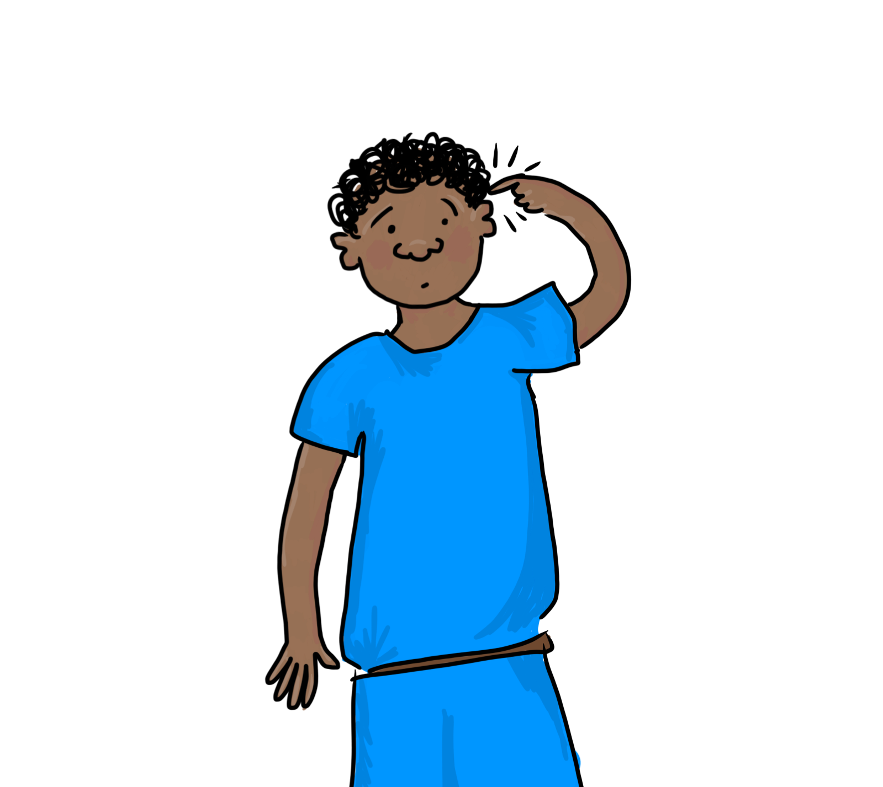
caput mihi dolet
click to diagnose and treat the patient

Slide 8
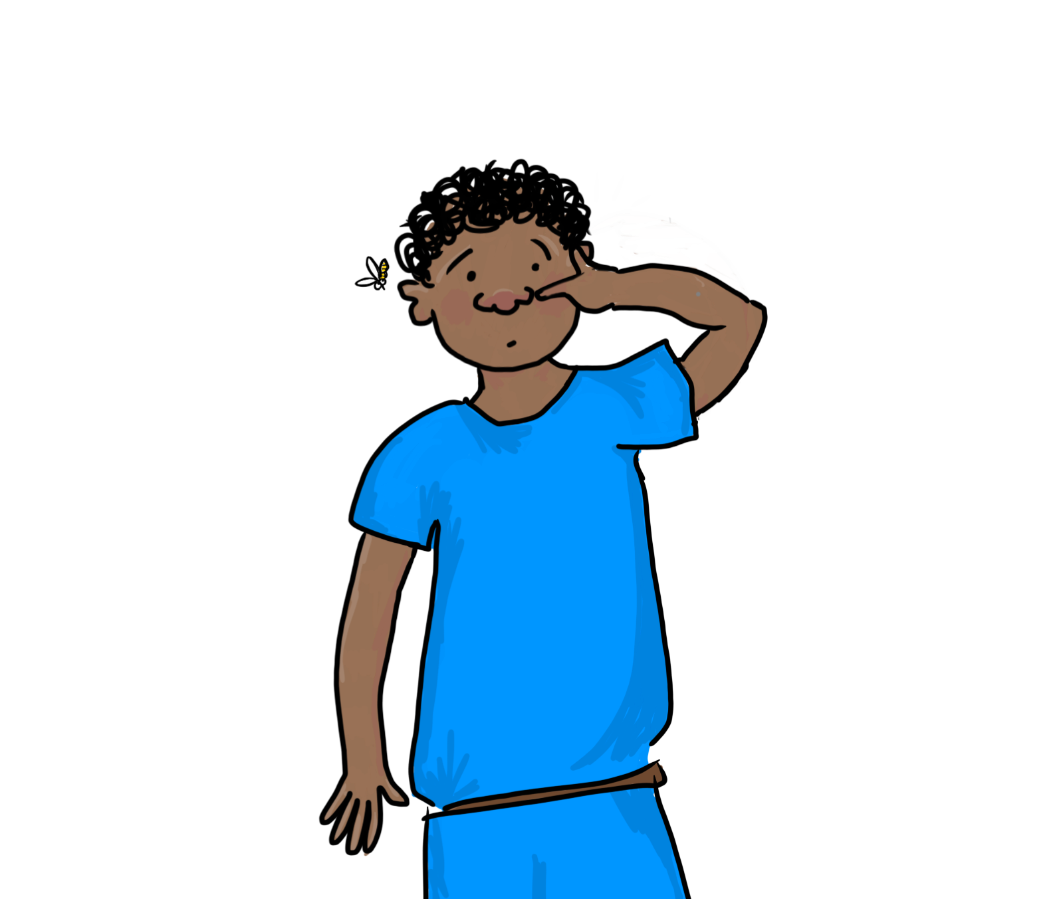
nasus mihi dolet
click to diagnose and treat the patient

Slide 9
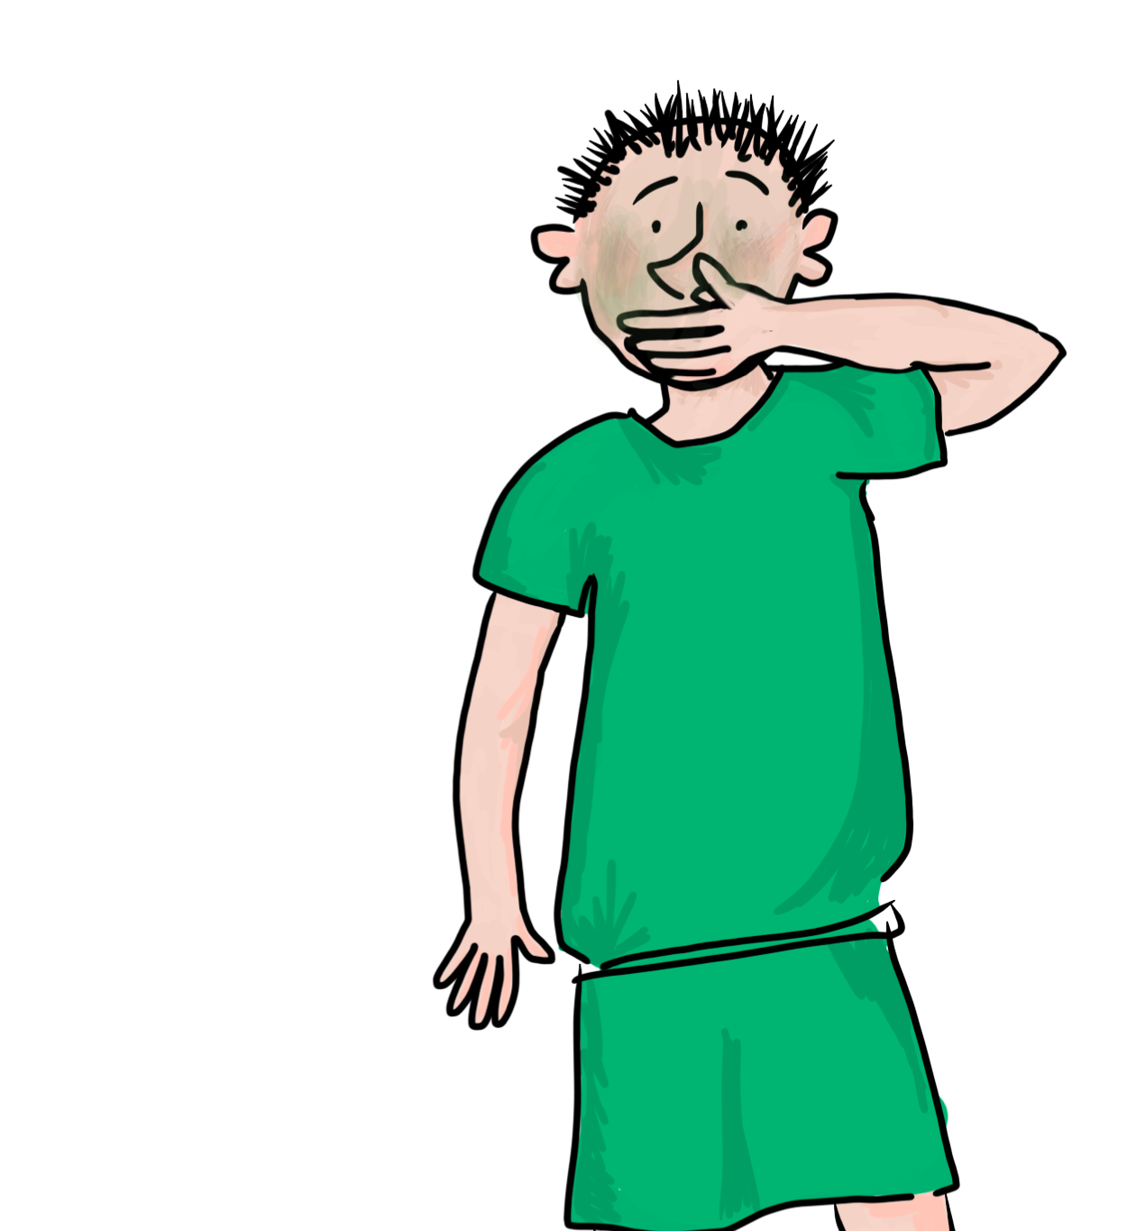
nauseo
click to diagnose and treat the patient

Slide 10
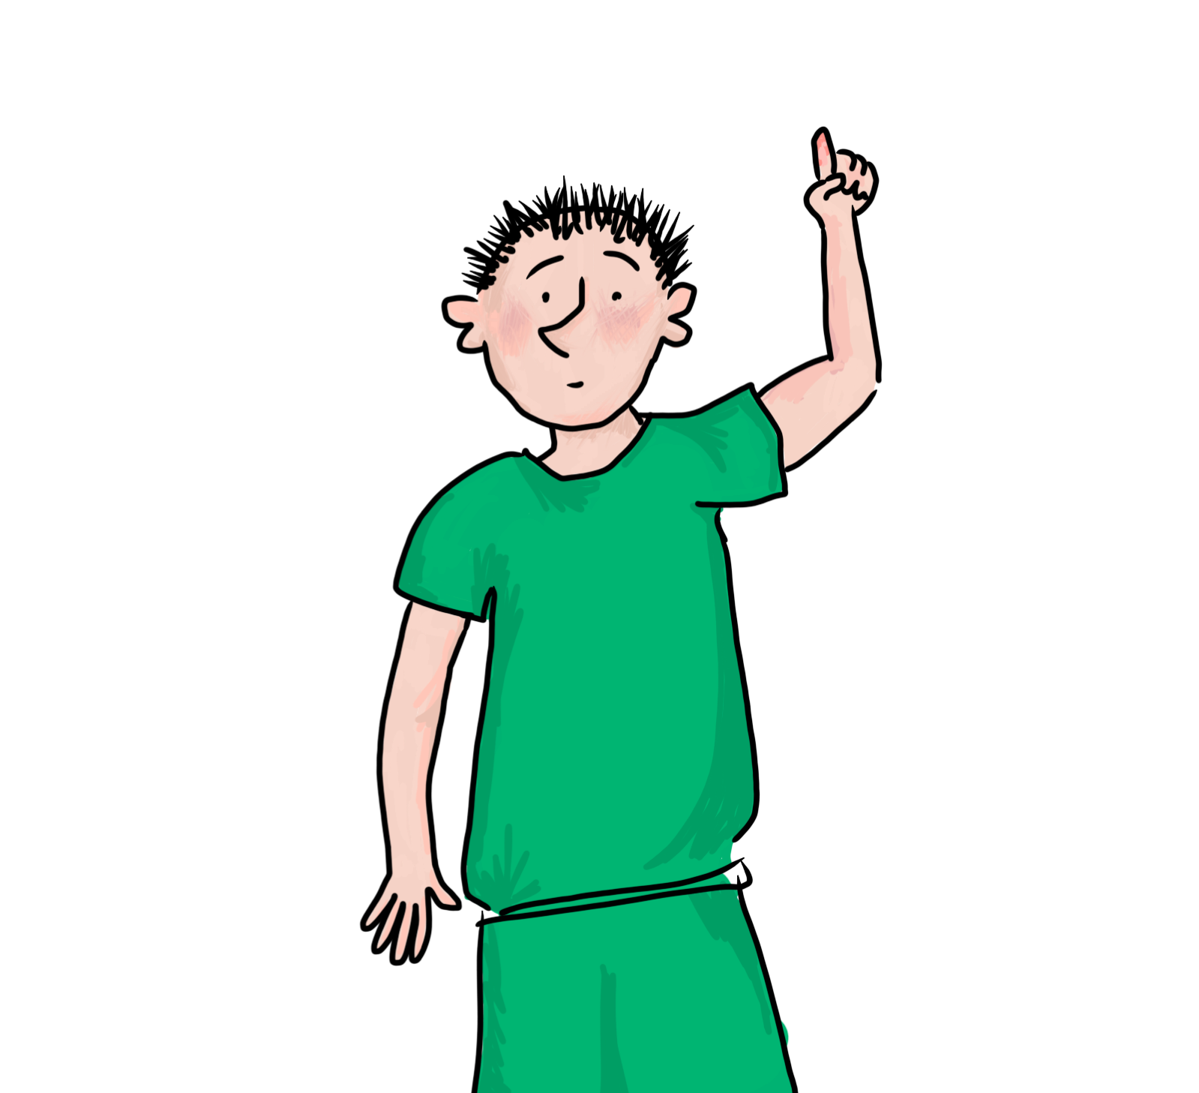
digitus mihi dolet
click to diagnose and treat the patient

Slide 11
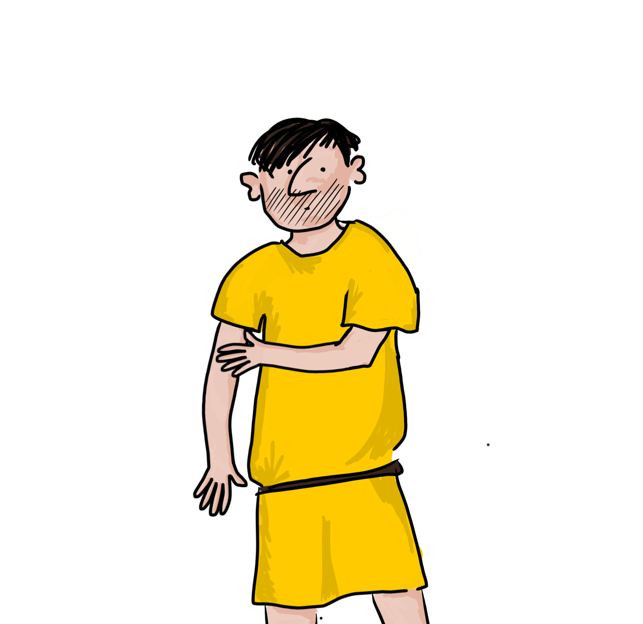
bracchium mihi dolet
click to diagnose and treat the patient

Slide 12
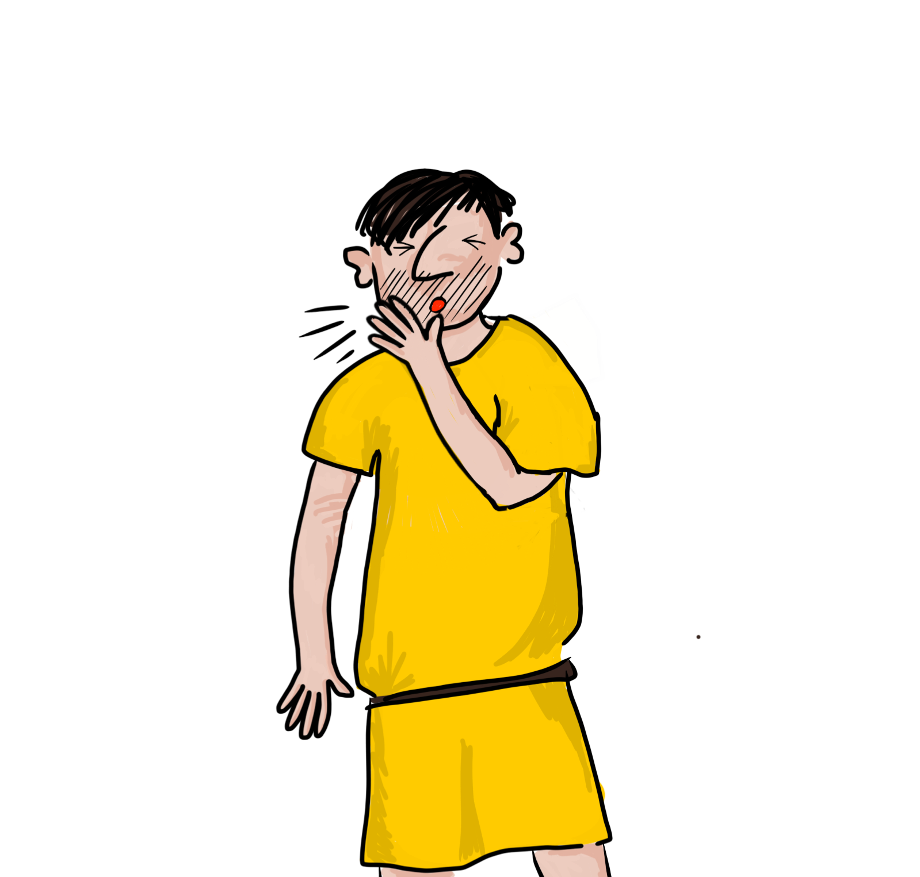
tussio
click to diagnose and treat the patient

Slide 13
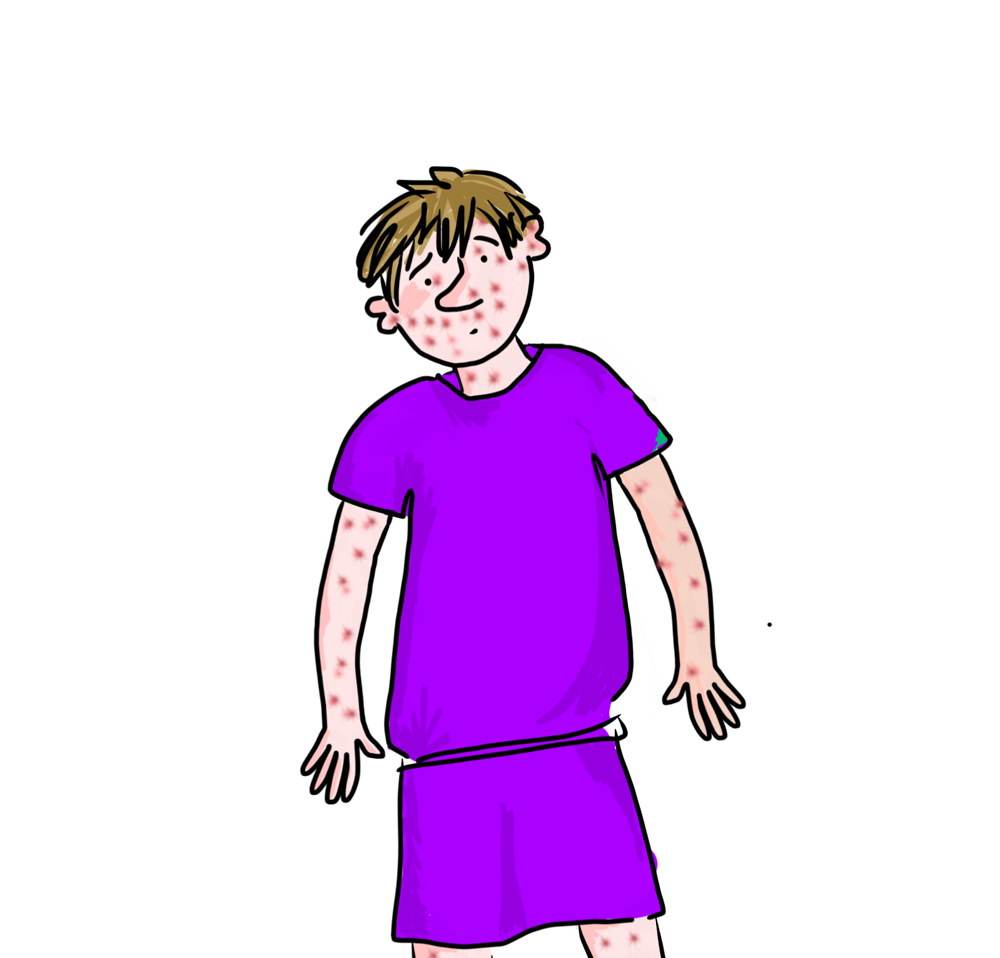
maculas habeo
click to diagnose and treat the patient

Slide 14
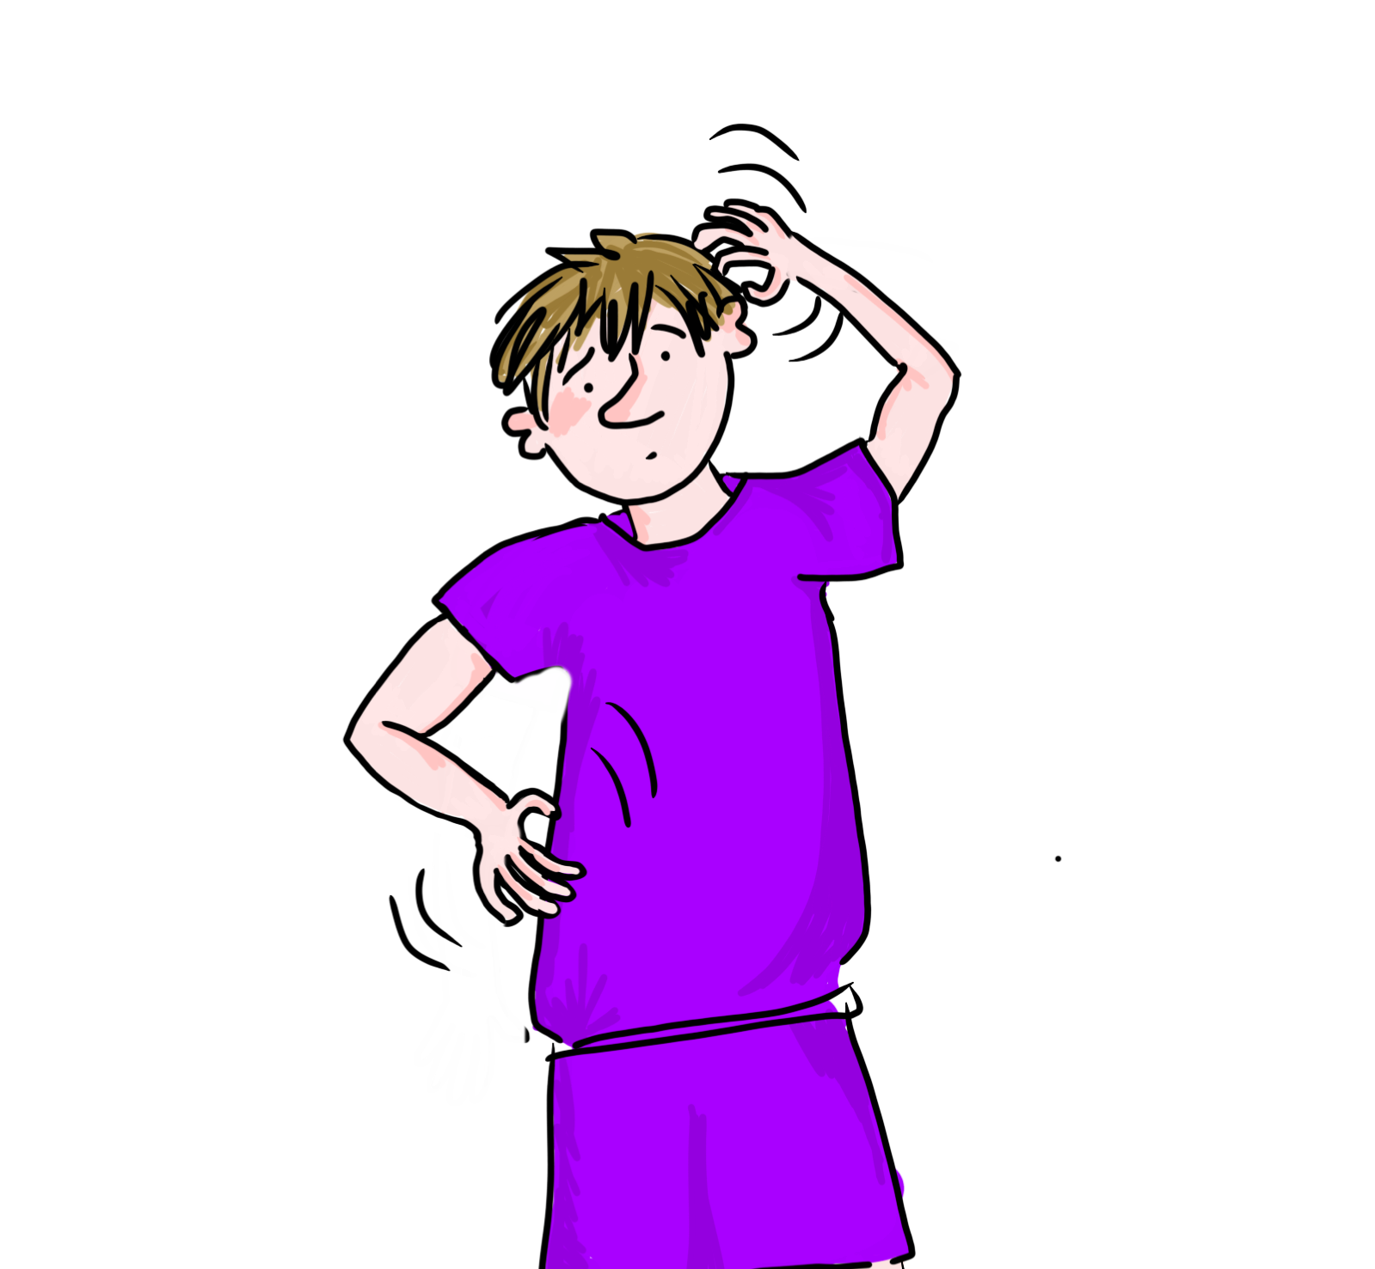
prurio
click to diagnose and treat the patient

Slide 15
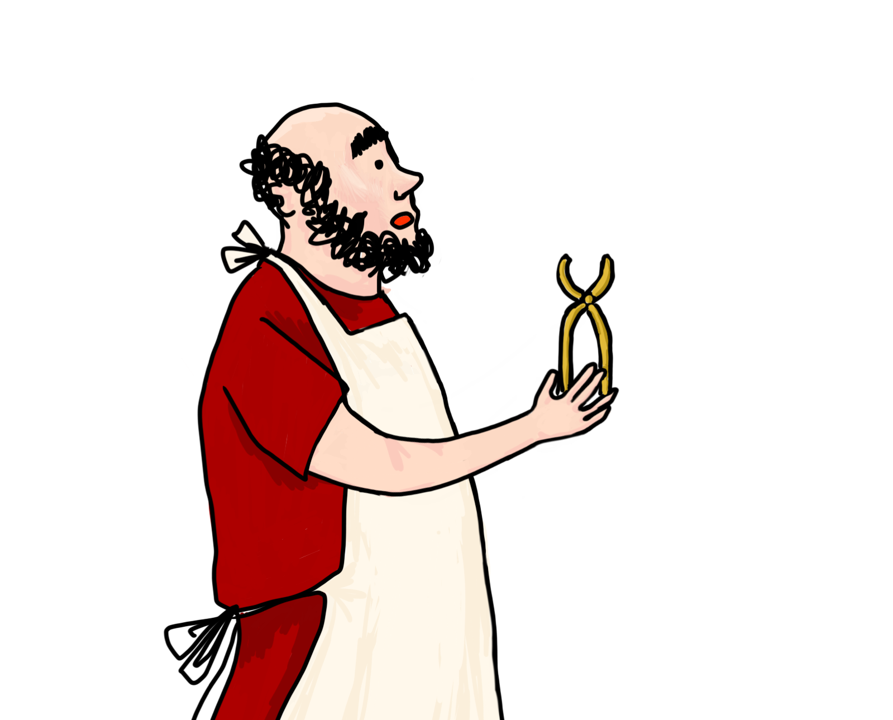
sagitta inest.
necesse est sagittam extrahere!
Will the patient be cured?

Slide 16
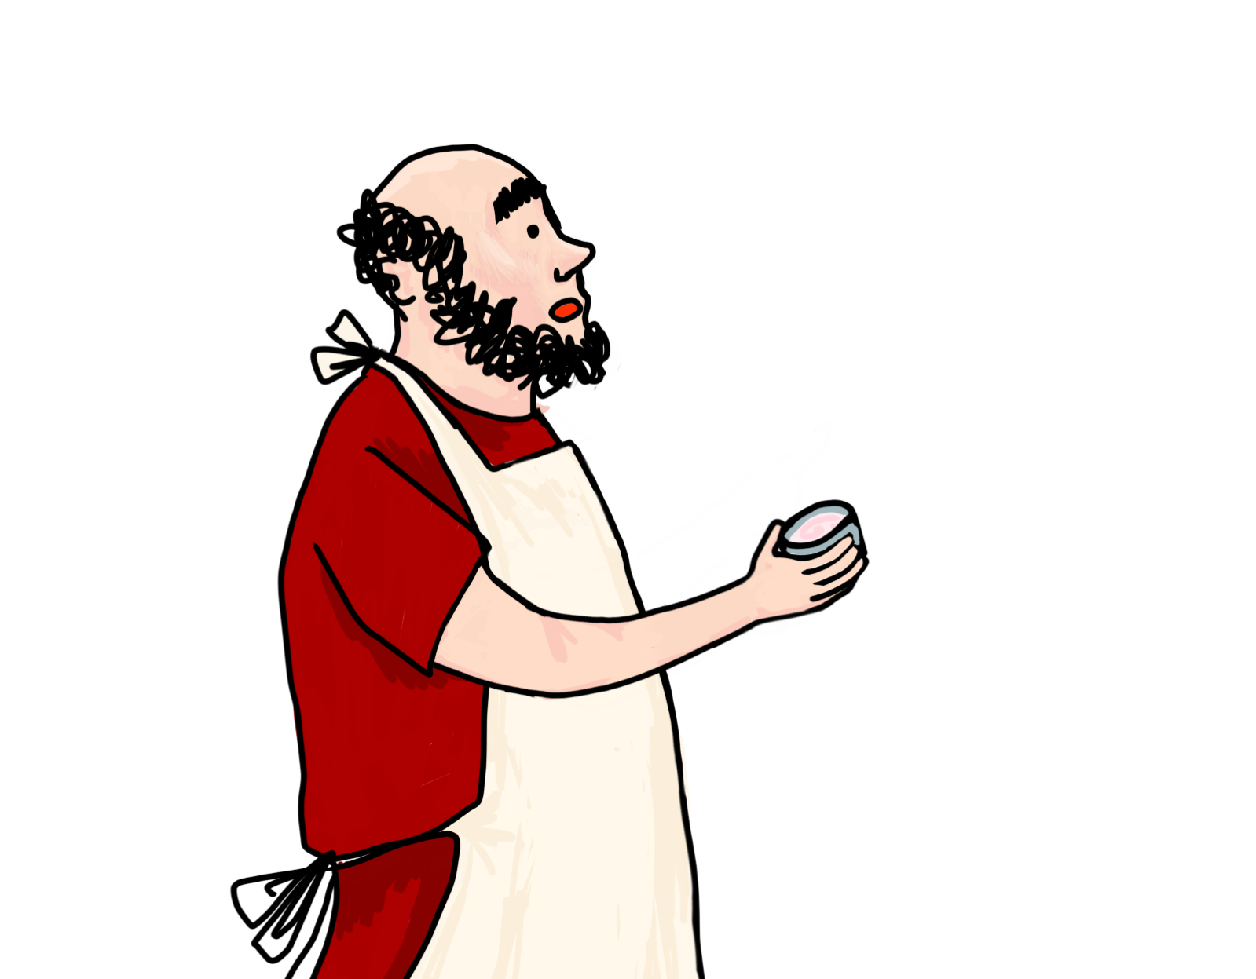
vespa nasum mordet.
hoc impone!
Will the patient be cured?

Slide 17
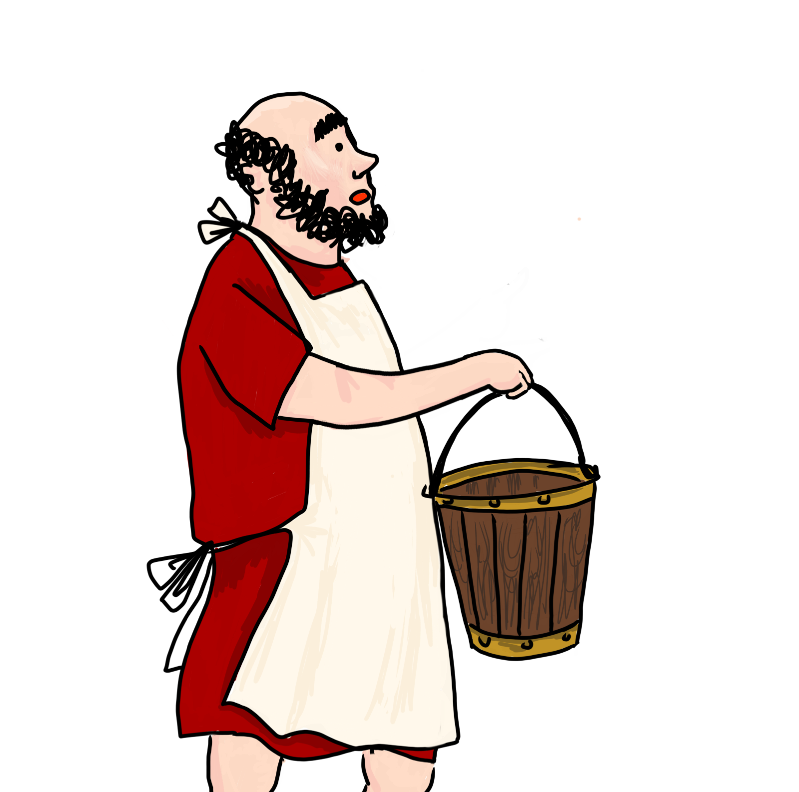
ecce situla...
Will the patient be cured?

Slide 18
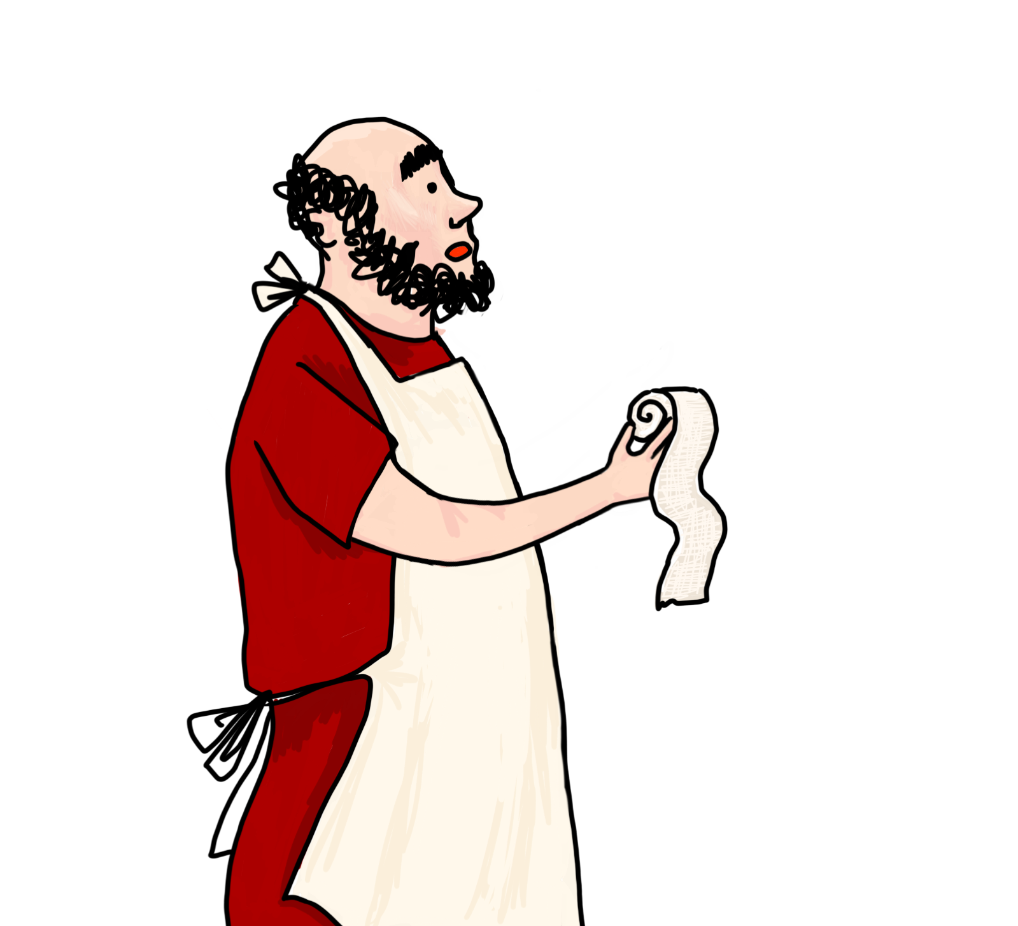
necesse est digitum deligare
Will the patient be cured?

Slide 19
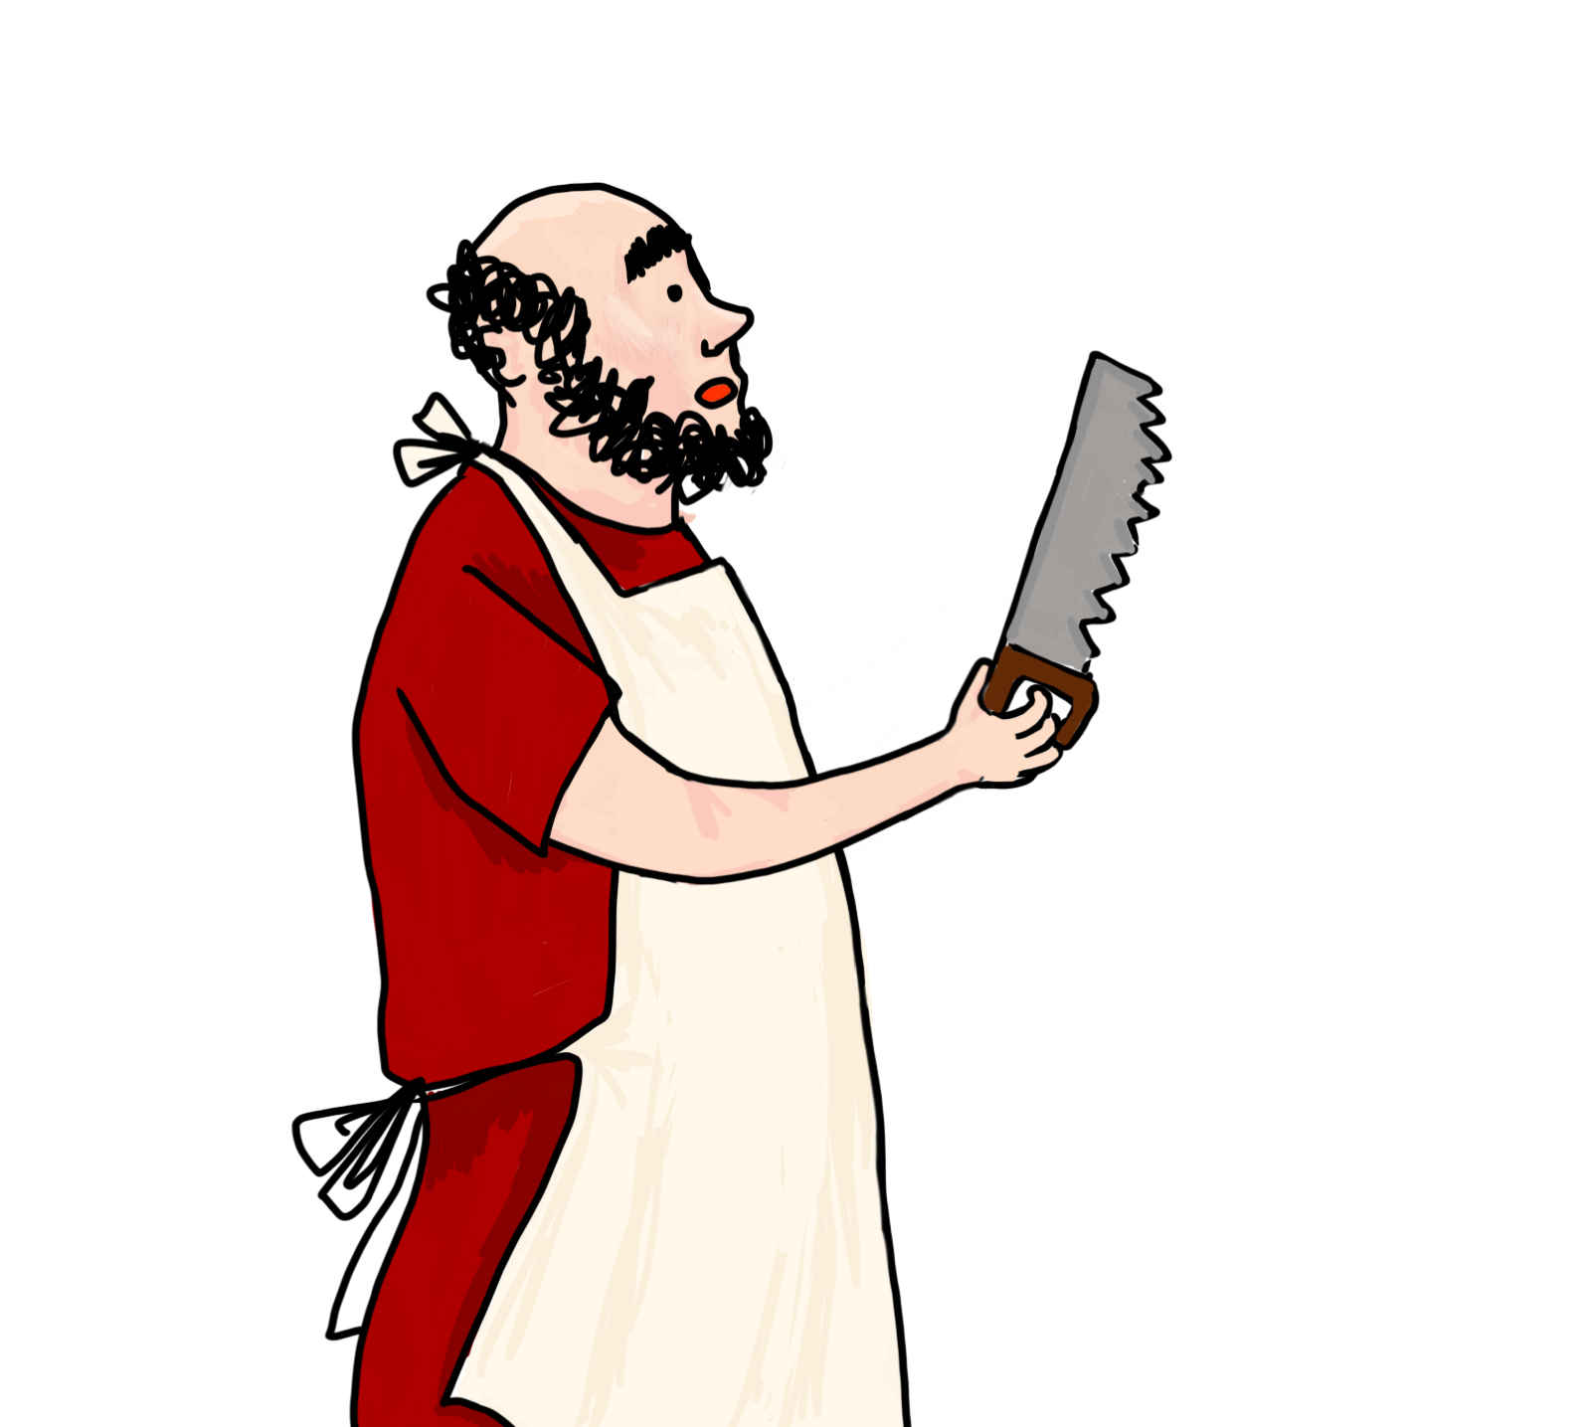
fractum est.
necesse est bracchium amputare!
Will the patient be cured?

Slide 20
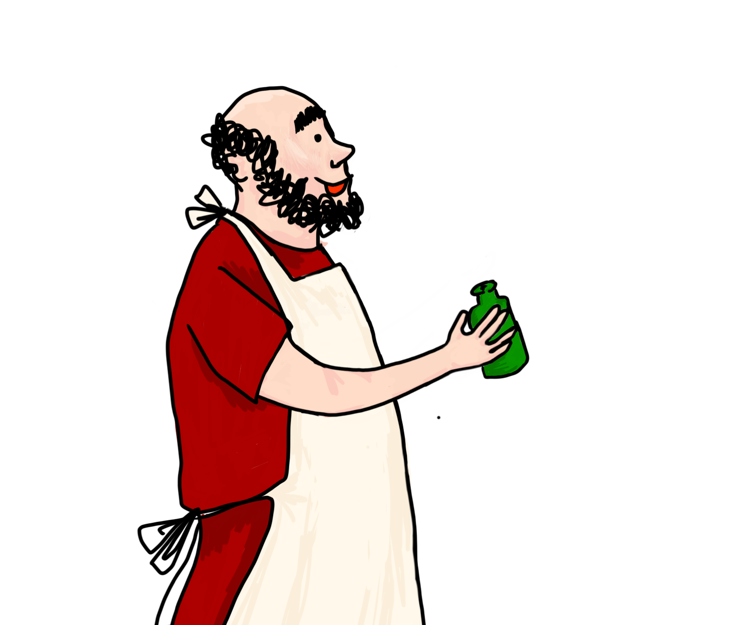
hoc bibe!
Will the patient be cured?

Slide 21
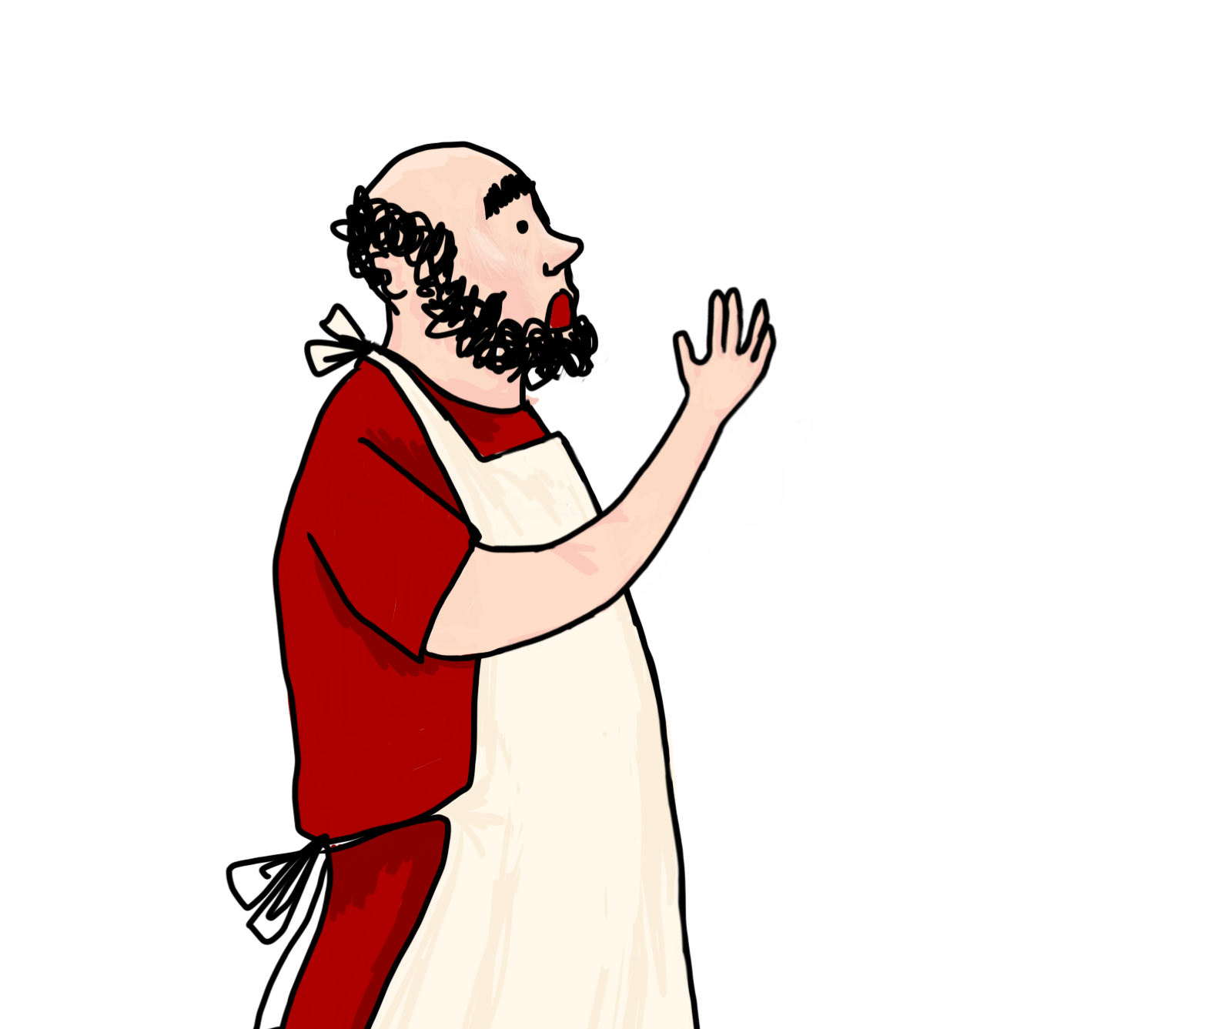
pestem habes.
nulla spes manet...
Will the patient be cured?

Slide 22
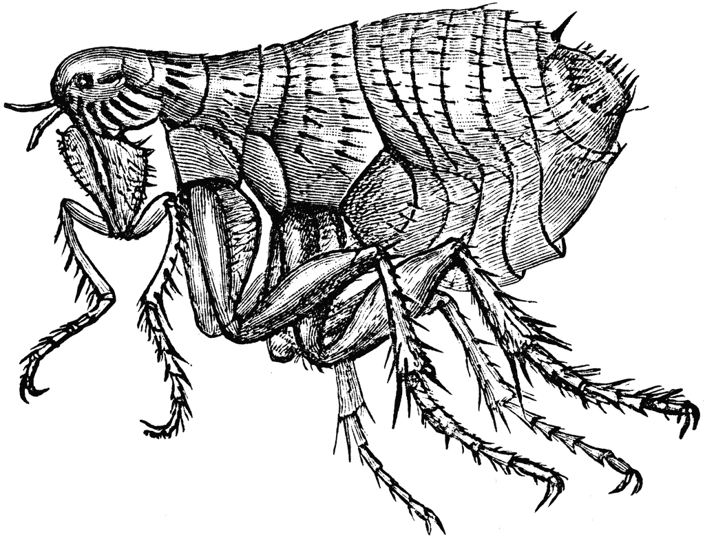
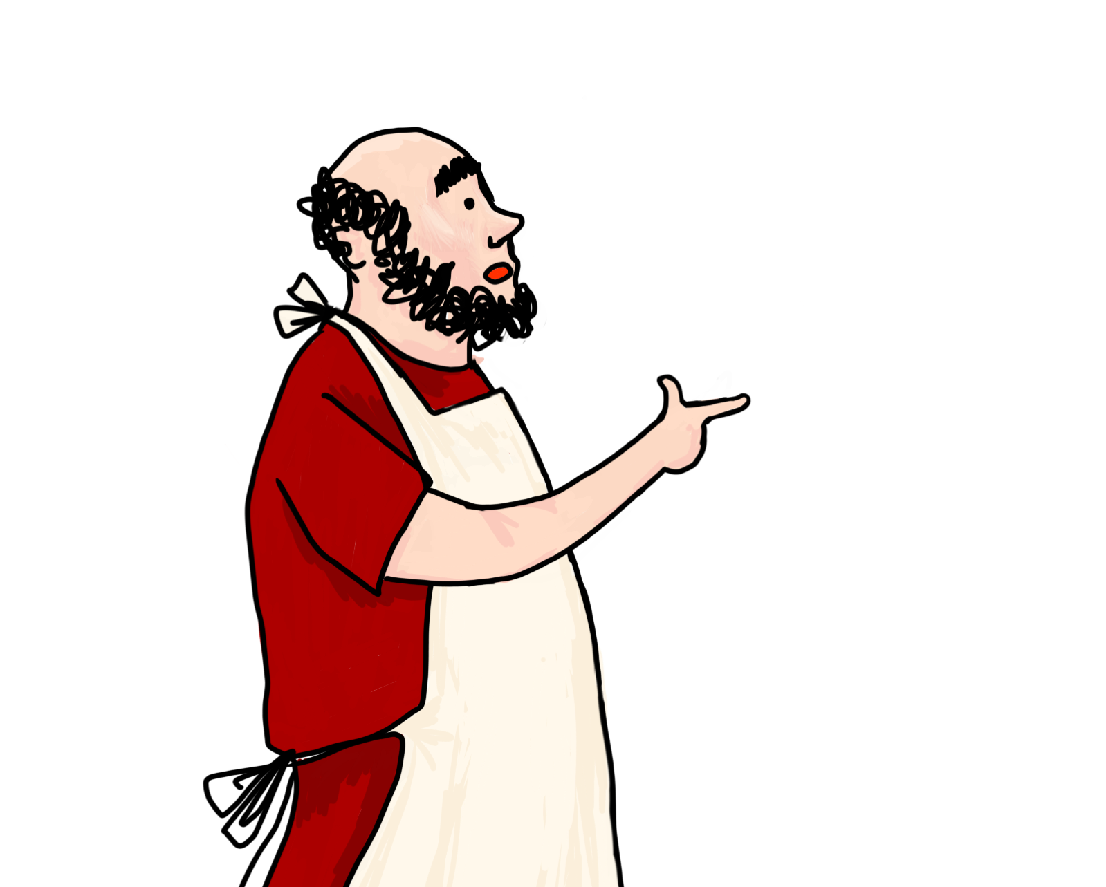
pulices habes! necesse est tibi tunicam lavare!
Will the patient be cured?

Slide 23
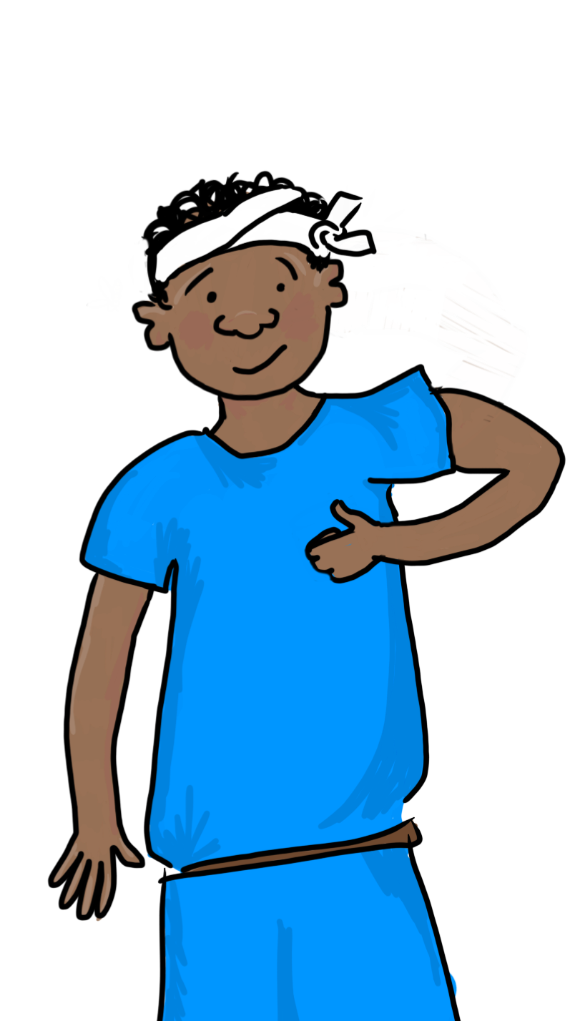
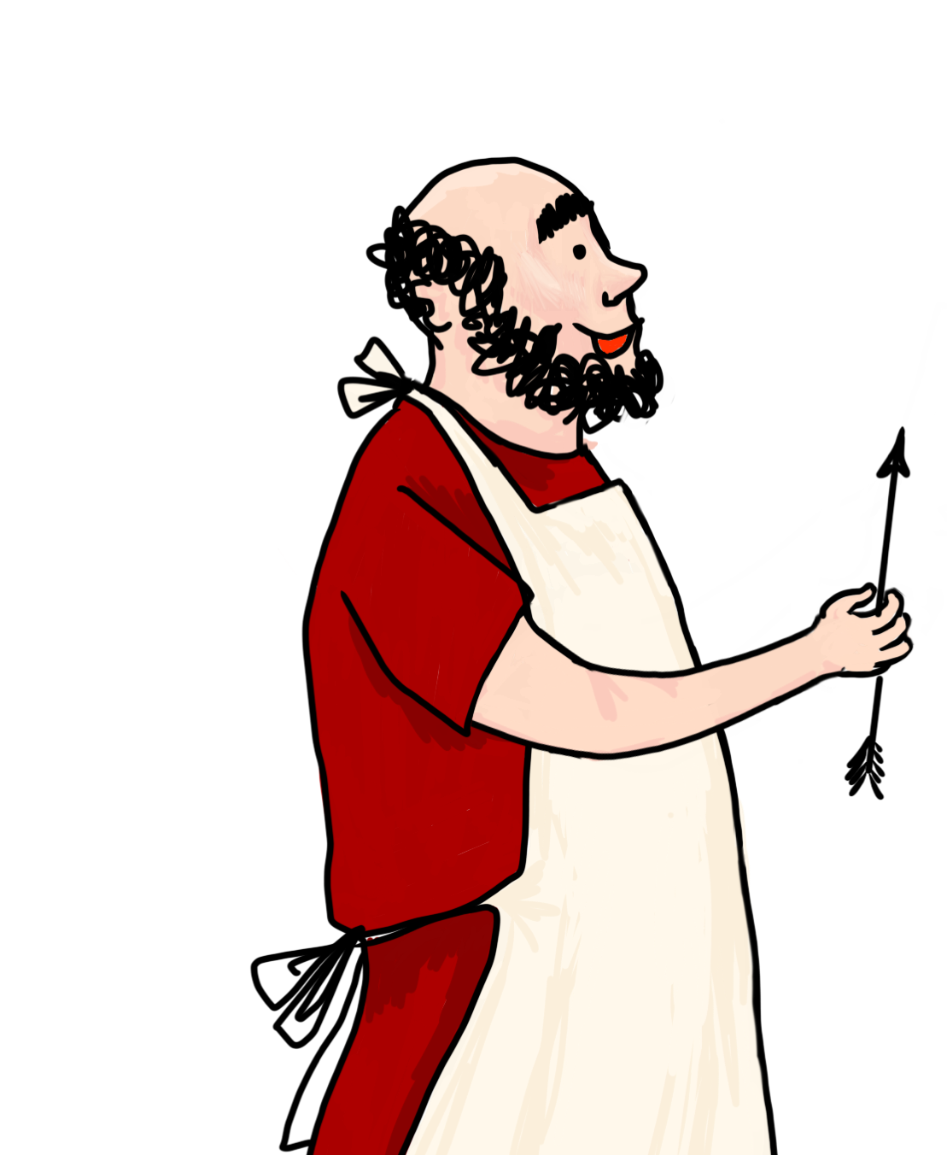
convalescis
gratias tibi ago
iterum lege!
Choose again!

Slide 24
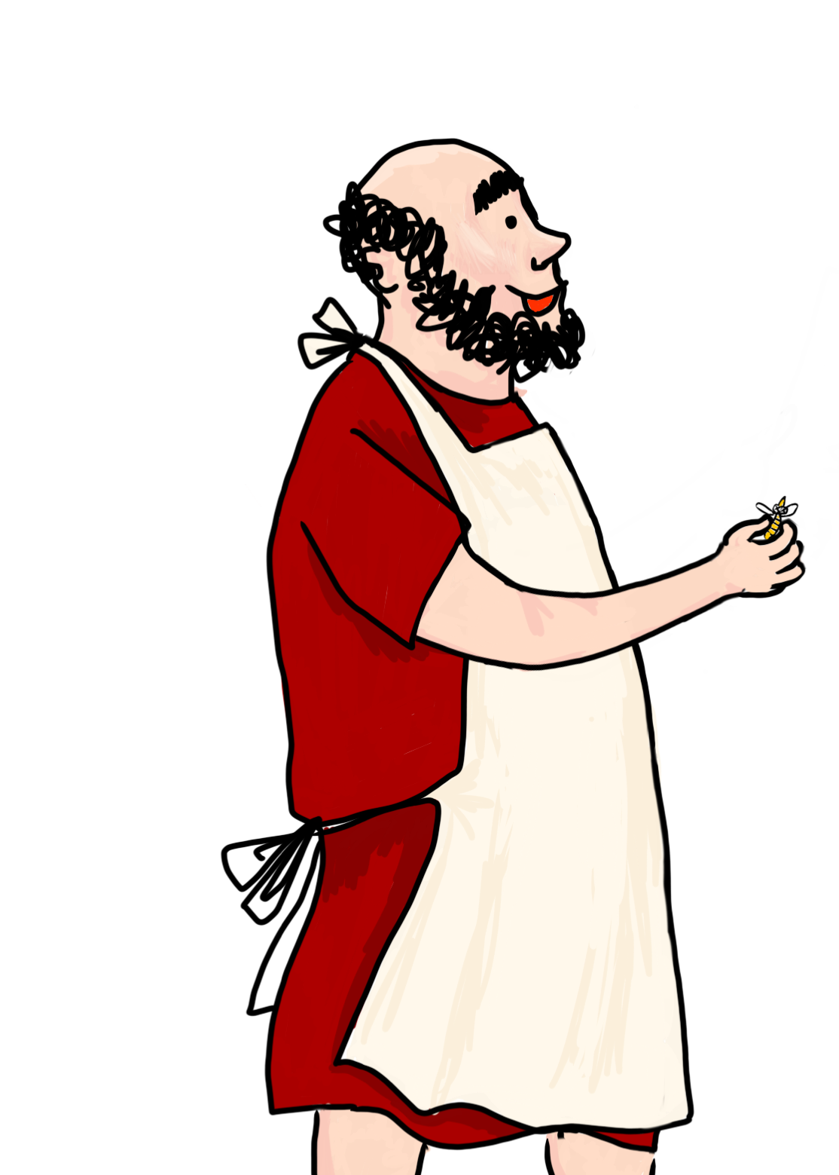
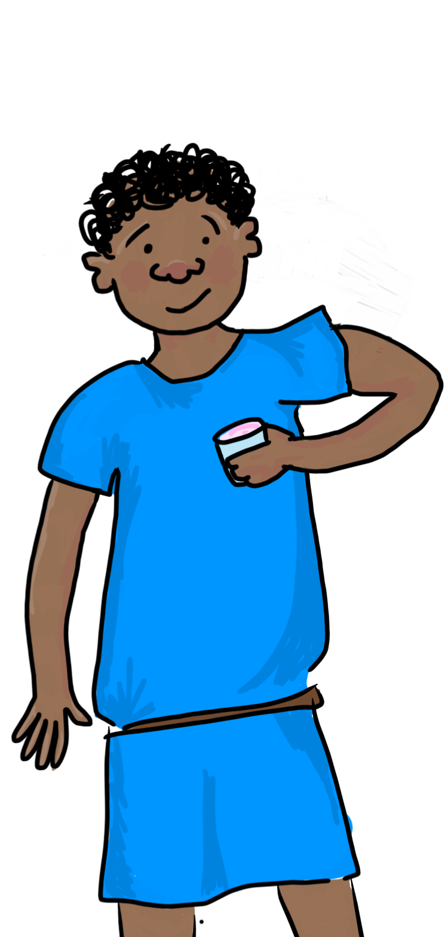
vespa mortua est!
euge!
iterum lege!
Choose again!

Slide 25
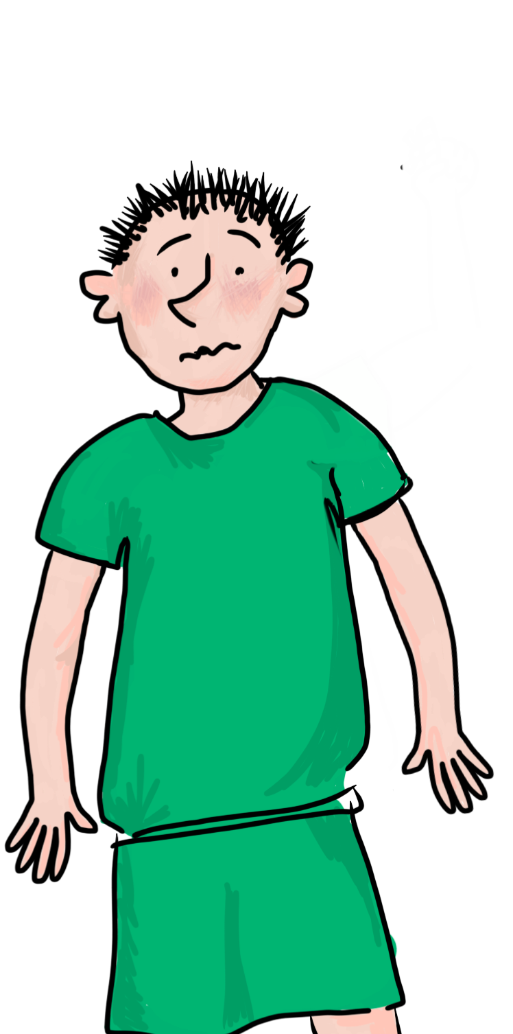
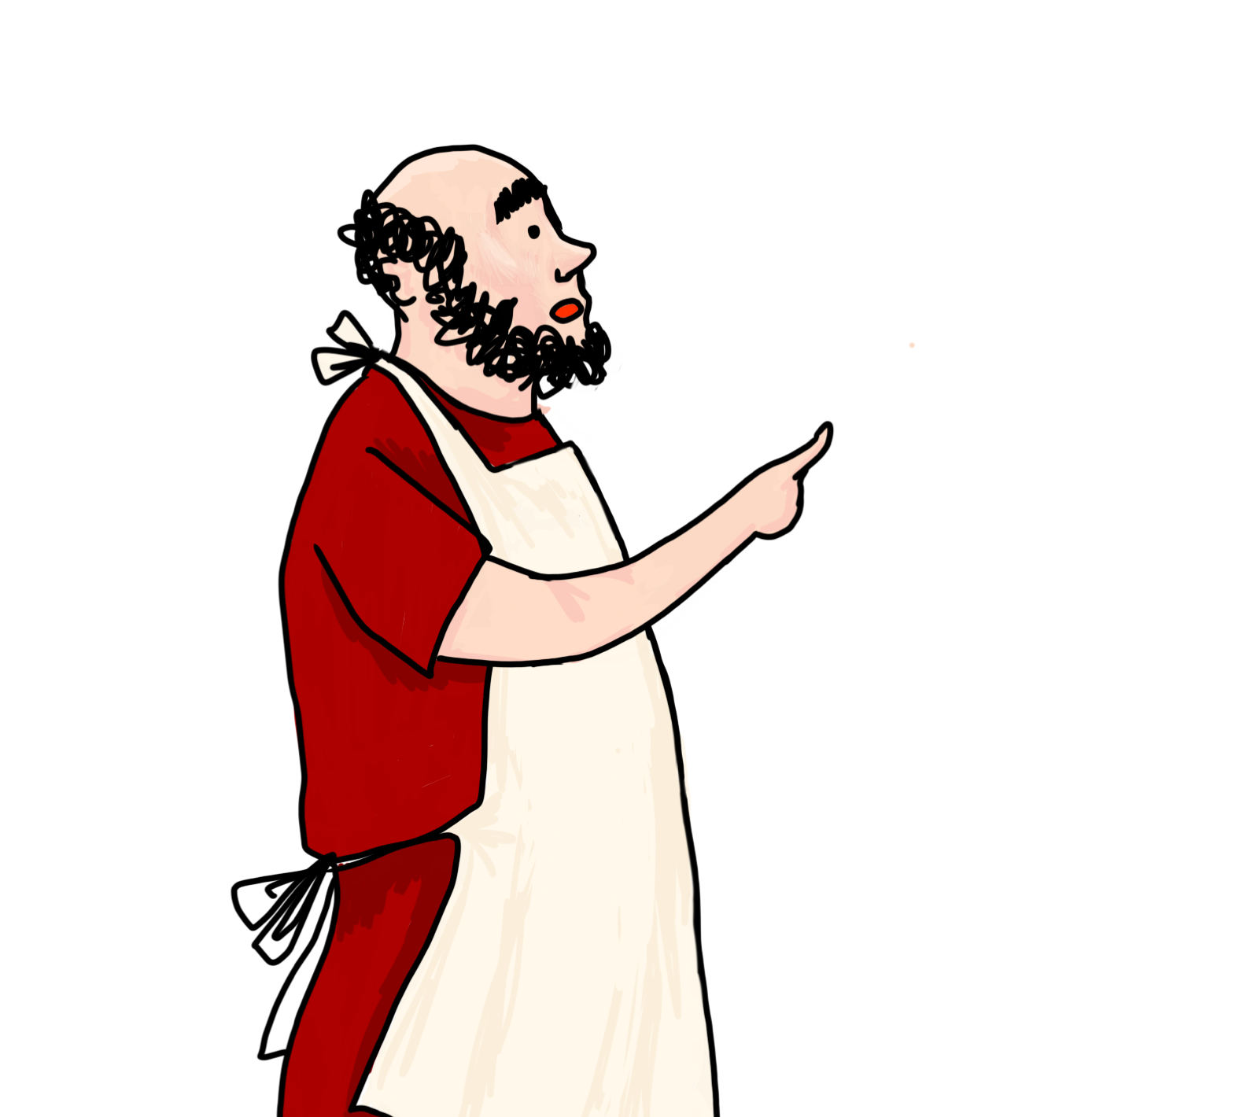

noli vinum bibere!
ita vero
iterum lege!
Choose again!

Slide 26
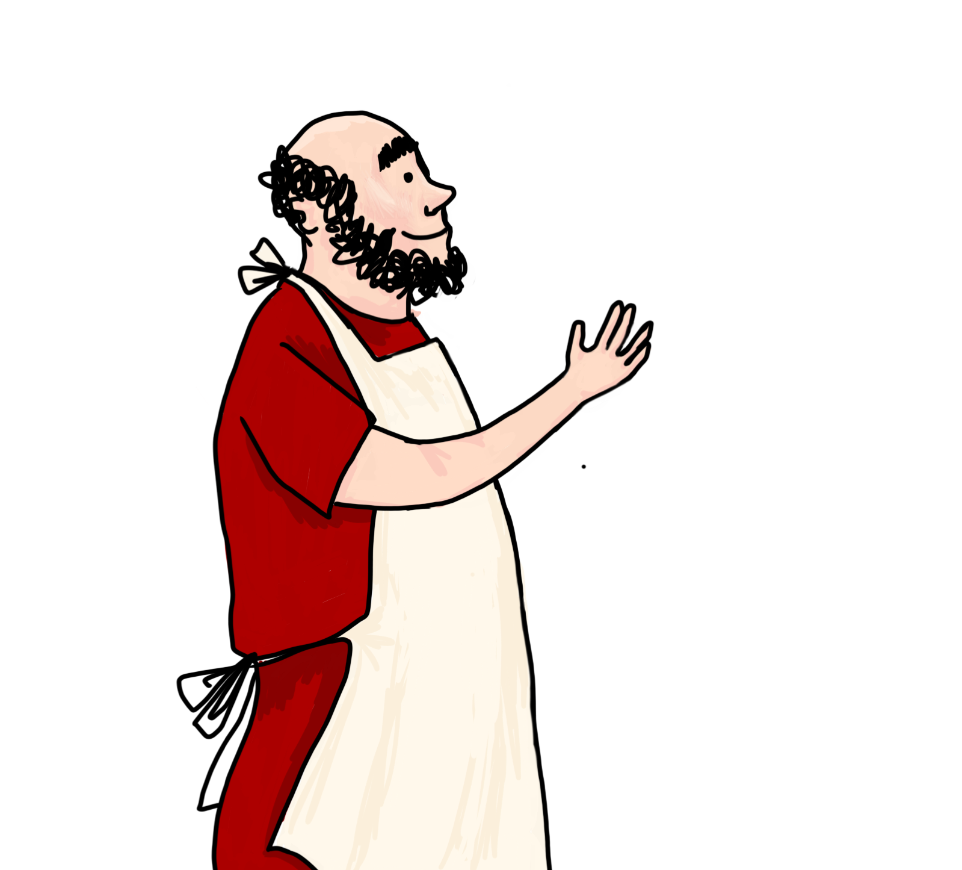
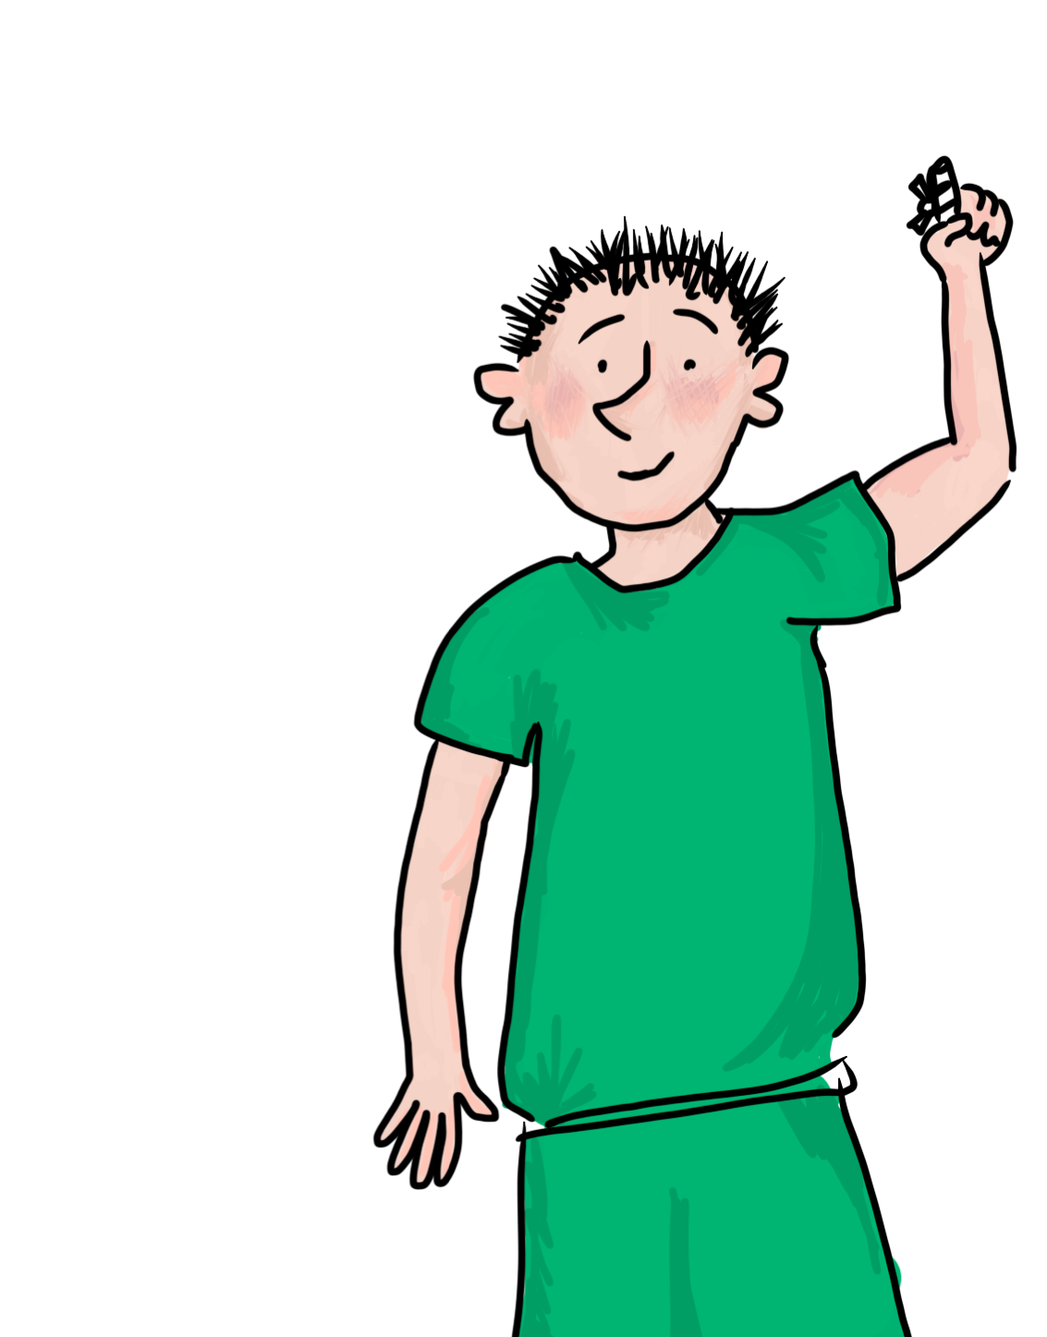
convalescis
gratias tibi ago
iterum lege!
Choose again!

Slide 27
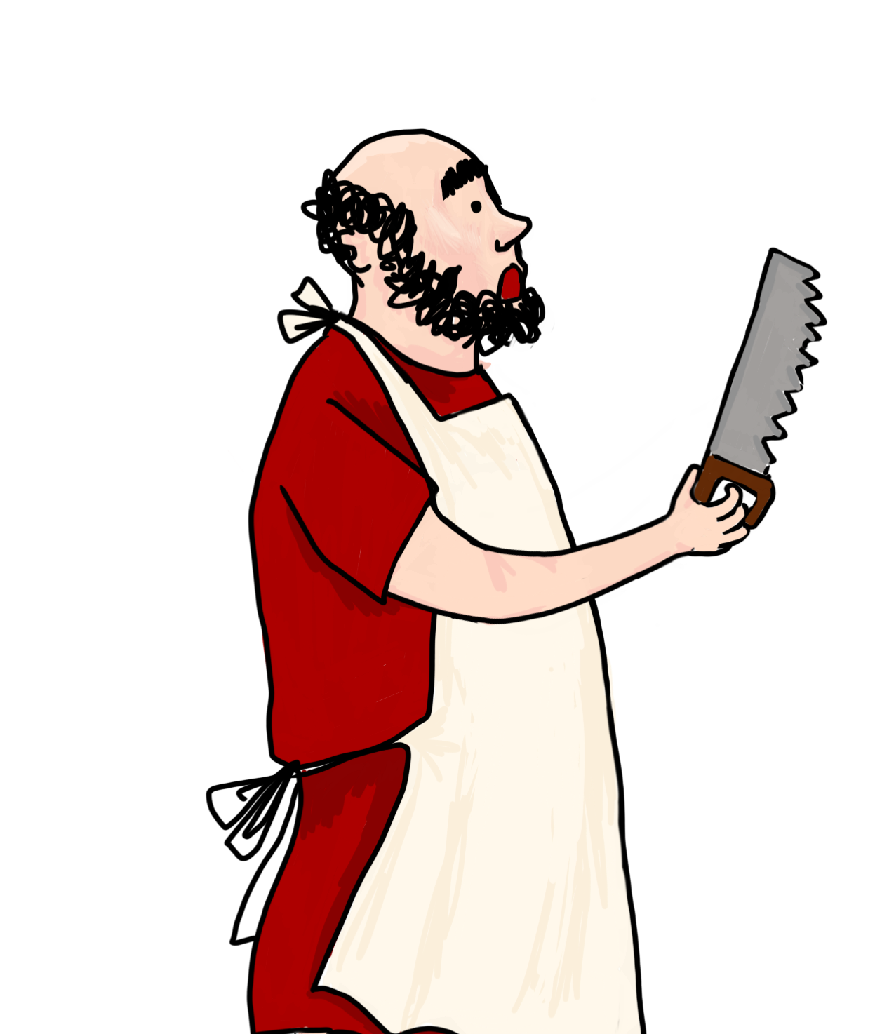
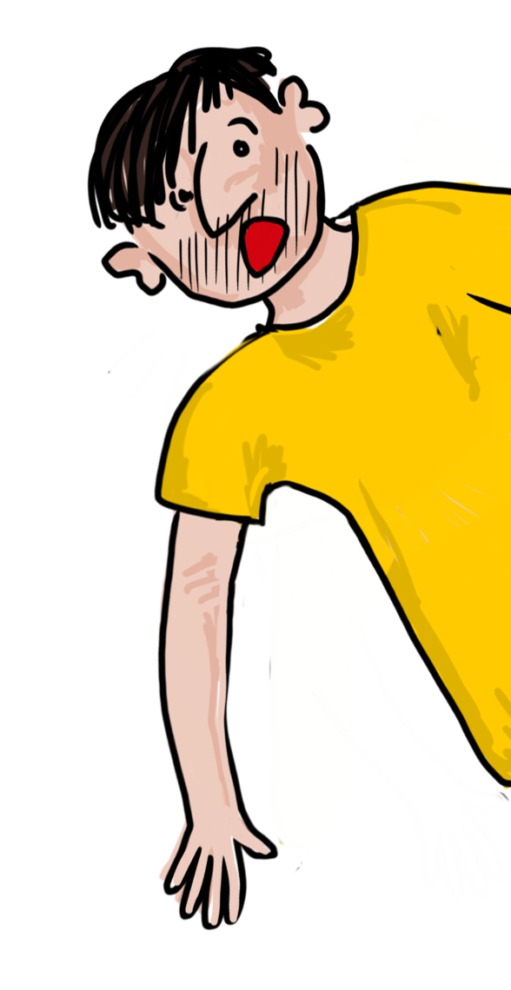
veni huc!
vale!
iterum lege!
Choose again!

Slide 28
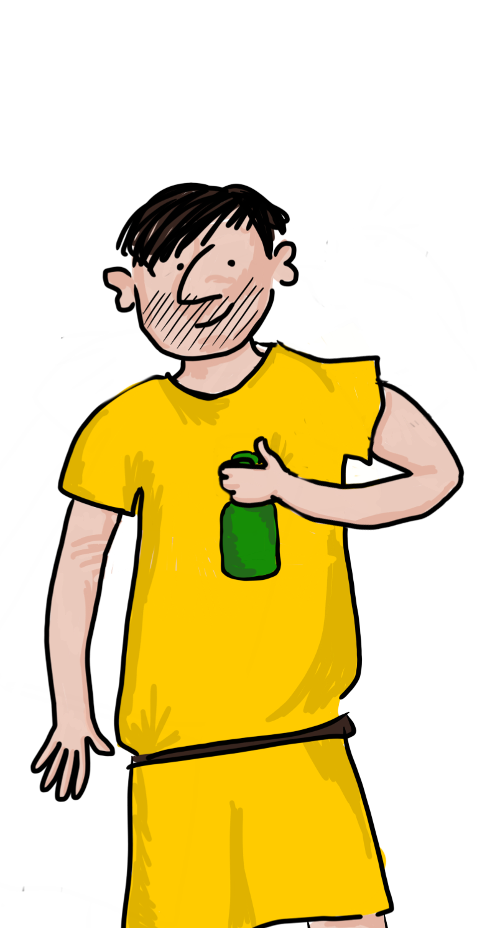
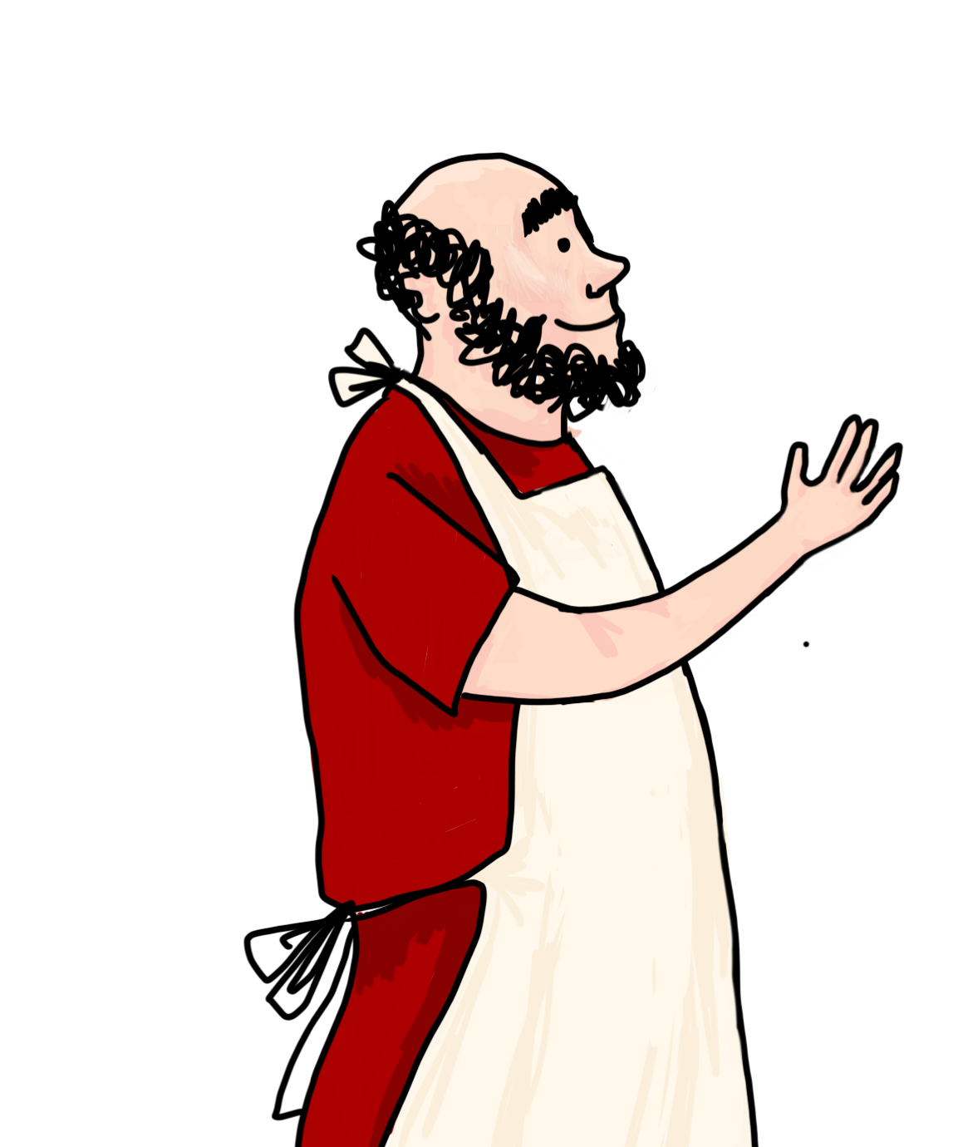
convalescis
gratias tibi ago
iterum lege!
Choose again!

Slide 29
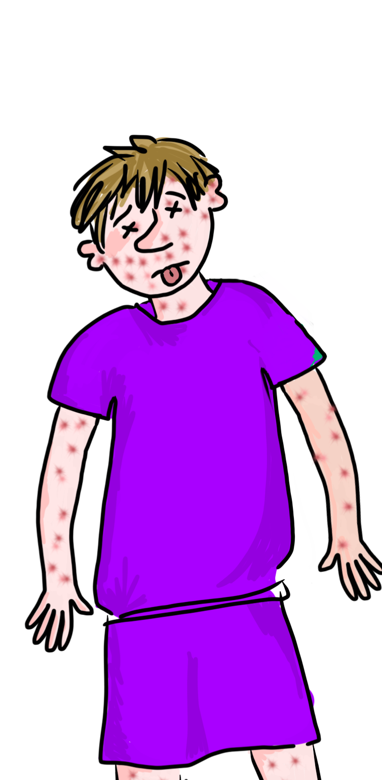
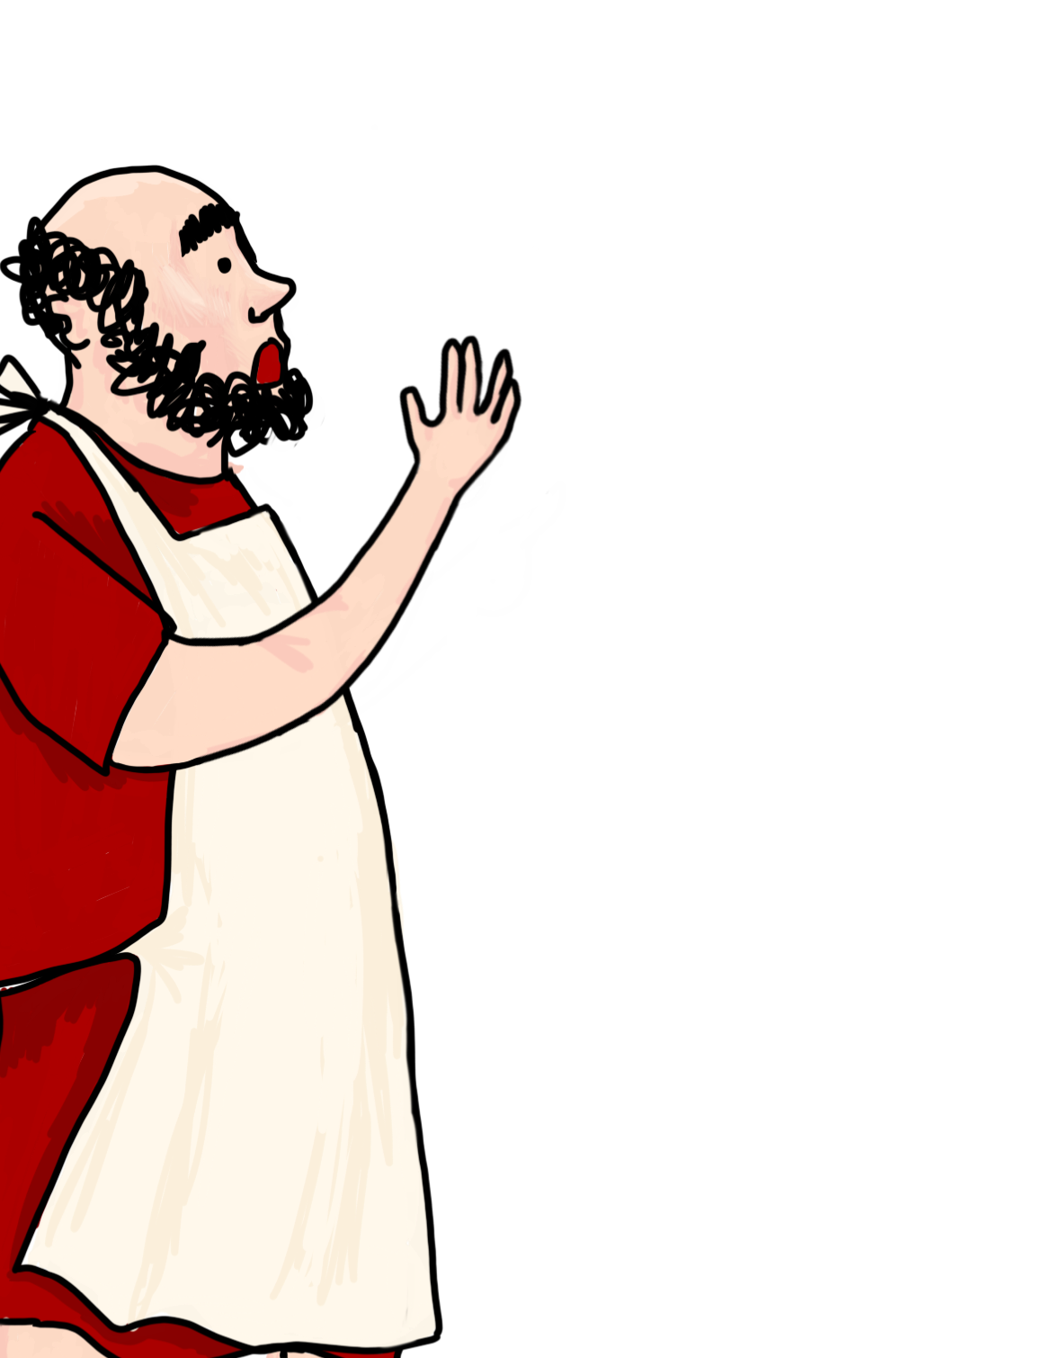
eheu! mortuus est!
iterum lege!
Choose again!

Slide 30
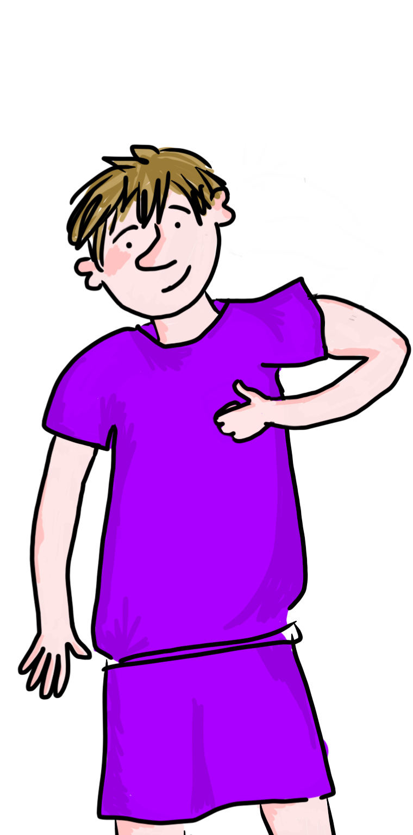
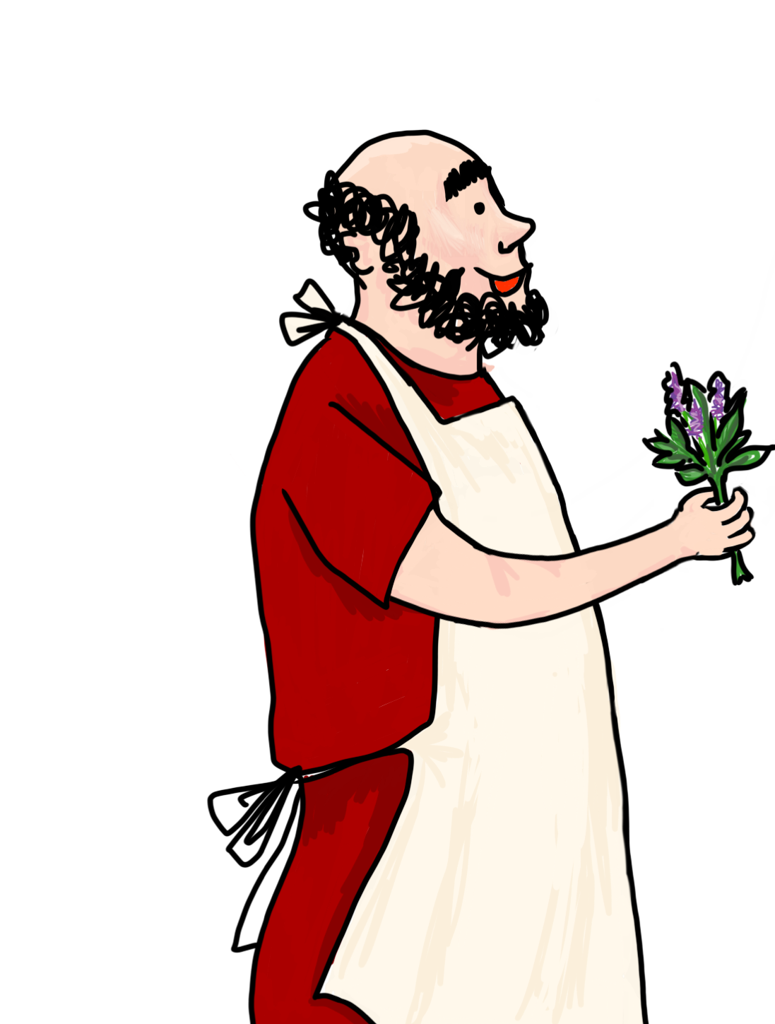
ecce pulegium!
valete pulices!
iterum lege!
Choose again!

